Slide 1



WELCOME
OUR 2026 PARTICIPANTS

Slide 2


WELCOME
OUR 2026 PARTICIPANTS

Slide 3






Thanks to our Sponsors and Exhibitors

Slide 4
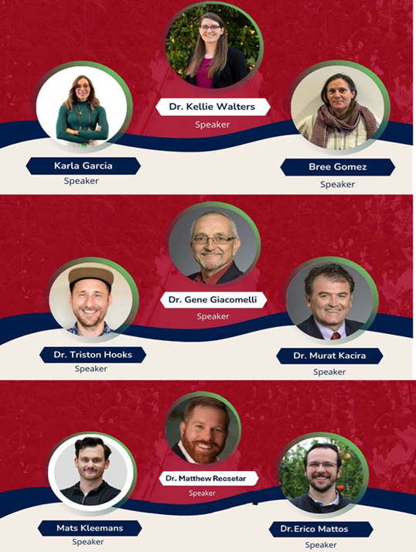
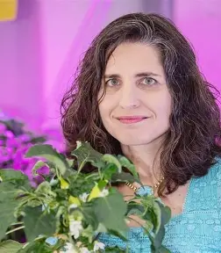


Thanks to
Our Invited Speakers

Slide 5

Thanks to
OUR TEAM MEMBERS FOR THEIR ENTHUSIASM AND ASSISTANCE
CAC Staff, Arturo Baez, Mark Carson, Tilak Mahato, Tanner Conrad,
all volunteering graduate and undergraduate students
ORGANIZATION AND DEVELOPMENT COMMITTEE
Amanda O’Reilly, Aaron Tevik, Triston Hooks, Matthew "Rex" Recsetar, Bree Gomez, Gene Giacomelli, Kevin Fitzsimmons, Goggy Davidowitz, David Bogner, and Murat Kacira

Slide 6
Thanks to
AMANDA O’REILLY
Program Outreach Coordinator
DAVE BOGNER
Director, CALES Cyber Communications and Technologies

