Slide 1


Day 1 : Fundamentals of Controlled Environment Agriculture (CEA) and Hydroponics
Greenhouse Design Basics (for Plants)
Dr. Gene Giacomelli
Emeritus Professor, Biosystems Engineering
The University of Arizona
25th Annual Arizona Greenhouse Crop Production
& Engineering Design Short Course
Developed, Organized and Presented by
Members of the UA-CEAC with invited colleagues and guests
Acknowledgement to my educators and mentors
who with their passion, creativity and design expertise got us here today
Controlled Environment Agriculture Center
(UA-CEAC)
The University of Arizona
Tucson, AZ

Slide 2
How did we get here?
‘Recent’ Developments of Technology and Understanding for commercial CEA…..
1970’s
Hydroponics commercialized - NFT (nutrient film technique)
Rockwool Substrate - Old Top drip irrigation - new inert substrate
Oil fuel energy crisis!
Late 70’s into 1980’s
Energy Conservation - screens, double-layer glazing, waste heat use
‘Elementary’ Computer control
HPS lighting
Co-Generation (now CHP) natural gas to heat + electricity + CO2
Mechanized Materials Handling and Space Utilization
Plant breeding – Focused for tomato, lettuce, cucumber, pepper

Slide 3
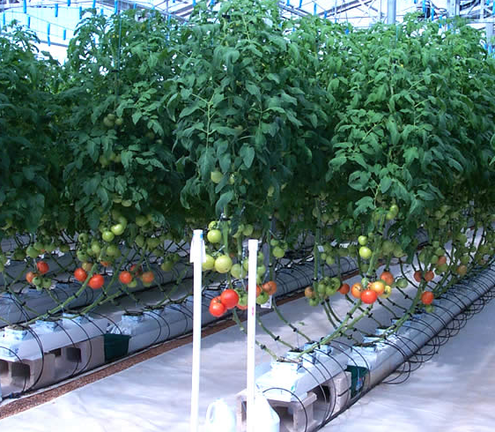
How did we get here?
‘Recent’ Developments of Technology and Understanding for commercial CEA…..
1990’s
early LED lighting studies (NASA)
‘Advanced’ computer control
IPM Best Practices
Mega-Greenhouses (+50 acres, 20 ha under one roof )
2000’s
Micro-Greenhouses (high tunnels, 24 x 100 ft, 7 x 30 m)
LED Lighting systems
Sensors for controls
People’s Markets - Demand for local grown, safe, quality, etc
Data-base information decision-making

Slide 4
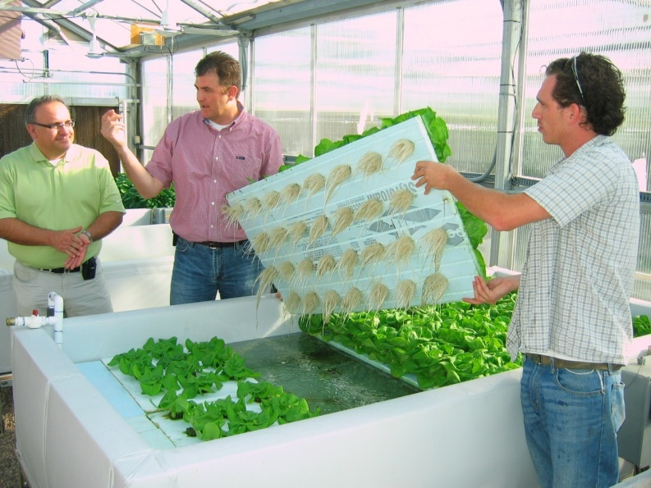
How did we get here?
‘Recent’ Developments of Technology and Understanding for commercial CEA…..
2010’s
Data-Analytics management
Renewable energy – Energy Generation
Entrepreneurs, VC’s, “Closet & Basement Growers”
Vertical Farms, Urban Agriculture, Indoor Growing
Unconstrained Creativity and Applications - “Wild-West!”
$$$$ and more $$$$ invested
2020’s
Your thoughts….how you will take these 50-year basics and develop them?
Quiz during the Q & A!

Slide 5
Thought[ful] List for Greenhouse Design Planning
25th CEAC Greenhouse Short Course
Dr. Gene Giacomelli giacomel@ag.arizona.edu
April 2026
Crop[s] to be grown
Environmental needs? Plant physical needs? Labor requirements? Market availability?
Understand every task of the plant required in the production process
Climate conditions at the location of the greenhouse
Need climate for the time of year to produce crops
Required: Temperature [minimum night and maximum day]
Optional for Location: cloud cover, wind, body of water, elevation
Grower’s production experience
Soilless culture in pots, hydroponics [what specific type], aquaponics
Market
Researched? Established? Neither?---go back, begin again!

Slide 6
Thought[ful] List for Greenhouse Design Planning
25th CEAC Greenhouse Short Course
Heating
If the outside air temperature at your site during crop production will be significantly less than the minimum night air temperature required for the crop[s]….
then heat is required to produce a quality crop in a prescribed timeframe
Passive solar for high tunnel for portion of the seasons - electrical power not required
Controlled fossil fuel heater - electrical service required, or see CEAC off-grid greenhouse
Source of heat: Hot air or hot water
Distribution: fan heat exchanger, overhead hot water pipes, under bench heating, floor heating
Goal: Maintain plant setpoint air temperatures for day and night

Slide 7
Thought[ful] List for Greenhouse Design Planning
25th CEAC Greenhouse Short Course
Ventilation
Ventilation is air exchange from outside into greenhouse for cooling, moisture reduction, and CO2
Once a greenhouse is covered, a ventilation system is always required!
Exhaust fans for positive, controlled ventilation. electrical power required
Roof peak and sidewall openings for natural air exchange based on winds, height of roof peak and size & number of openings
Neither system can control to below [or even equal to] outside air temperature

Slide 8
Thought[ful] List for Greenhouse Design Planning
25th CEAC Greenhouse Short Course
Cooling
Evaporative cooling can control to below outside air temperature [5 – 30 ºF cooling]
limited by the outside air humidity [greater humidity less cooling]
Wet pad wall opposite exhaust fan wall most common
Water cools the air by evaporating within the wet pad of the end wall and humidifies the incoming air which is moved through the greenhouse by the exhaust fan
Fog [or mist] cooling by spray nozzles located overhead throughout the greenhouse
More uniform within greenhouse and efficient cooling than wet pad
Challenging to maintain [water quality will block nozzles] and to control [must cycle to prevent wet plants]
Goal: Maintain plant setpoint air temperatures for day and night

Slide 9
Thought[ful] List for Greenhouse Design Planning
25th CEAC Greenhouse Short Course
Supplemental Lighting
Photosynthetic lighting and/or photoperiod control to compensate for natural environment
Shade/Energy Screen
Indoor mechanical system to deploy screen in the night for energy conservation [20 – 40% savings],
or for use in day for shading [20 – 30% light reduction] and some cooling [1 or 2 degrees]
to reduce plant water stress
Monitoring and Control [Dr. Kacira next speaker!]
Monitor air temperature, humidity, sunlight and CO2
but control mostly based on air temperature
Computer control can do complex controls with types and numbers of sensors
store and analyze data, communicate with operator, and provide information
to the grower to make better decisions for more efficient production.

Slide 10
Thought[ful] List for Greenhouse Design Planning
25th CEAC Greenhouse Short Course
Structure and Glazing
Structure: Single bay ground-to-ground [high tunnel] or single bay greenhouse,
or multiple-bay, gutter connected
Glazing: Glass or plastic [film or rigid], single or double-layers are general choices
Glass is forever, but expensive.
Plastic is less expensive; life is 20 – 25 years for double-wall rigid panels and 2 – 4 years life for the films [except ETFE, Tradename: F-Clean]
Double-layer air-inflated polyethylene film is very cost effective
Various additives in the plastics modify qualities
longevity, heat loss, condensation dripping, light quality and heat gain from the sun

Slide 11
Thought[ful] List for Greenhouse Design Planning
25th CEAC Greenhouse Short Course
Utilities
Necessary for operations: heating fuel, water source, electrical, communications, transport access, market access, sanitary disposal
Headhouse
Packing/shipping area, office, restrooms, lunchroom
Storage
Materials and Supplies, Equipment, Containers

Slide 12
Thought[ful] List for Greenhouse Design Planning
25th CEAC Greenhouse Short Course
Plant Nutrient and Water Delivery [Dr. Hooks this afternoon!]
Water quality - get a lab test of your water source!
Fertigation – creating nutrient formulation, deliver consistently and on-demand
Delivery to plant roots: All provide the same: water, nutrients, oxygen, removing salts, maintaining pH, without light
Top Drip
NFT
DWC [or floating rafts]
Ebb & Flow [or Flood & Drain]
Aeroponics
Match system type to crop - size, access requirements, opportunity to automate, ease of turnover, sanitation, maintenance, skill of labor required, logistics of plant and materials handling, failsafe!
Control of irrigation cycle - timer, substrate moisture content, %drainage

Slide 13
Thought[ful] List for Greenhouse Design Planning
25th CEAC Greenhouse Short Course
Final considerations for the profitable grower
Continually learn about plant care and needs
Share your experiences. Visit trade shows
Listen to the next generation of growers in your family and business community
Don’t block your future moves for development/expansion.
Plan your production space
Attend short courses until becoming board by having more experience than the teachers!

Slide 14
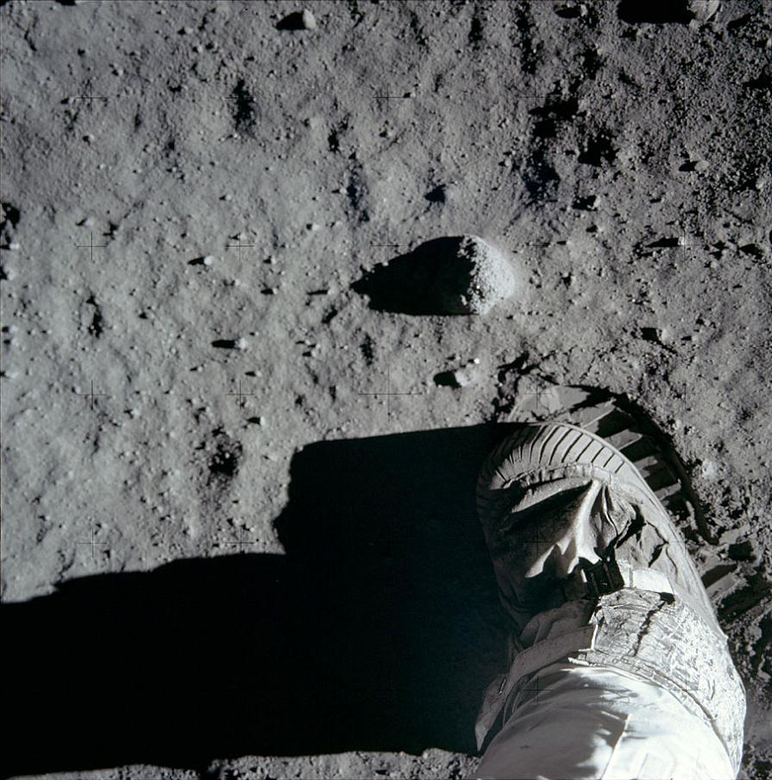
It’s time to move forward
Extraordinary times require
extraordinary steps…..

Slide 15
For Further Information
The CEAC (Controlled Environment Agriculture Center) and The University of Arizona are dedicated to development of CE (Controlled Environment) technologies and worldwide applications, and for educating young people about the science and engineering of CE and hydroponic food support systems, and the other CE applications.
We will implement an interactive outreach and educational program to promote the benefits of CE for food production for modern agriculture, as well as, the new technologies of CE for enhancing, restoring, and maintaining critical earth life systems and human quality of life scenarios.
CE systems will be developed to help feed the world, while utilizing energy, labor and water resources effectively, and CE will become the platform for applications of new technologies using plant physiological processes [biomass fuels]; for space colonization life support [recycling all resources]; for remediation of air [carbon sequestration] and water [salts, heavy metals]; and for phytochemicals and plant-made pharmaceuticals [lycopene, vaccines].

Slide 16
For Further Information
Dr. Gene Giacomelli
Biosystems Engineering, CEAC, giacomel@ag.arizona.edu
+1 520 990 0202
Prof. Gene Giacomelli is an emeritus faculty member within the Department of Biosystems Engineering at The University of Arizona, and former Director of the Controlled Environment Agriculture Center. Giacomelli has gained international reputation through his pioneering work and expertise in the area of protected crops. Growing food on other planets was one of the collaborative international projects that he led, which was supported by the NASA Space Grant Consortium at the University of Arizona. The focus is efficient use of water, energy and other resources for implementation of a food and life support system for Moon/Mars. The results from this project will be applied to Earth protected agriculture food production systems."
Notes:
Who is this speaker [not to be presented within the talk]

