Slide 1
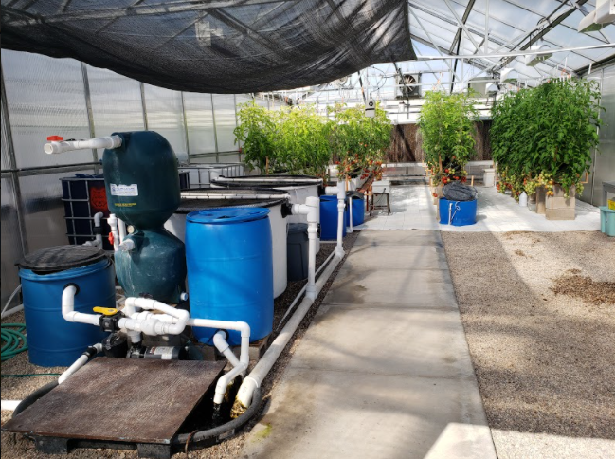
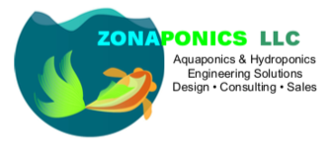

Aquaponics in CEA
Matthew “Rex” Recsetar, PhD
Assistant Professor Biosystems Engineering, Extension Specialist
© 2025 Matthew Recsetar

Slide 2
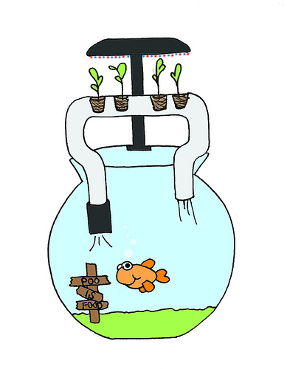
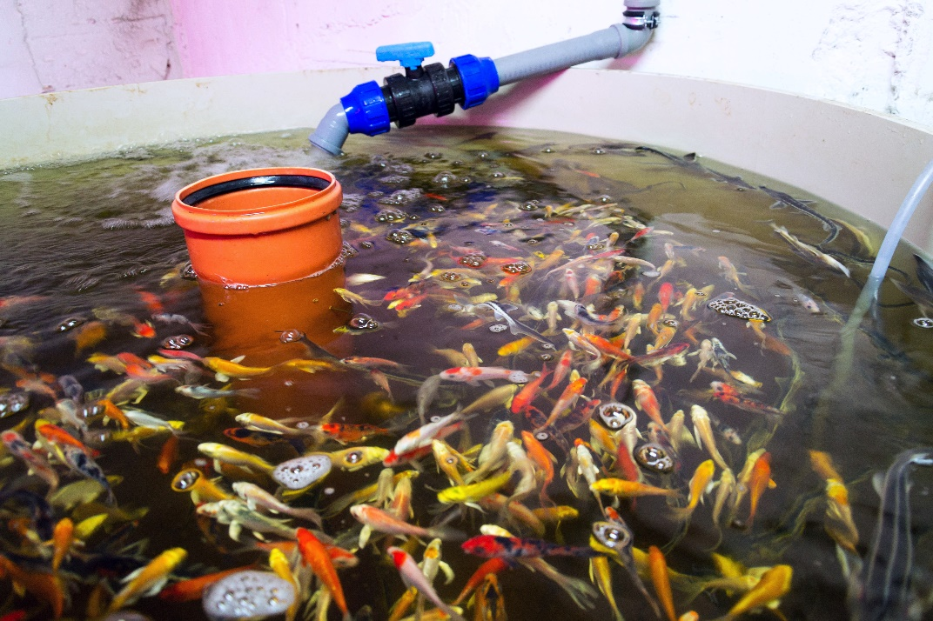
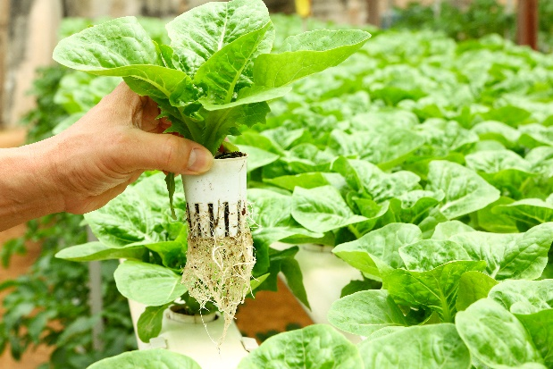
What is Aquaponics?
Combination of:
Aquaculture: farming of aquatic organisms under controlled conditions
Hydroponics: cultivation of plants in nutrient-rich soilless systems

Slide 3
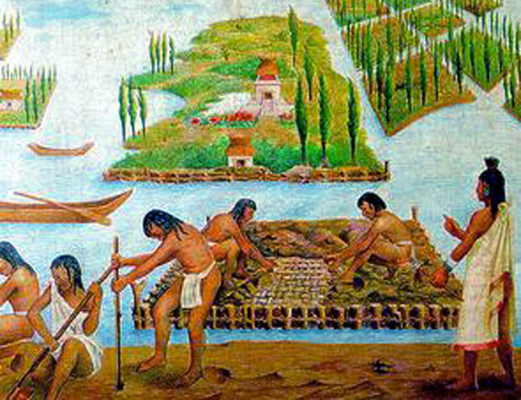
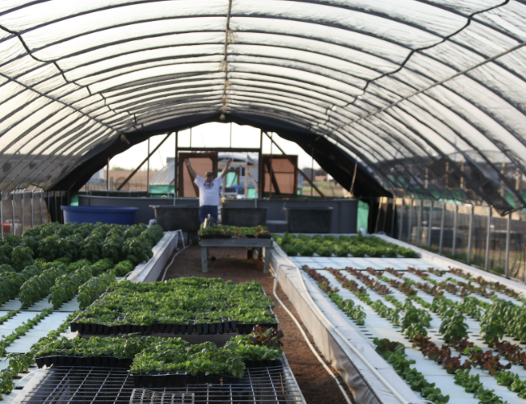
Is Aquaponics a New Technology?
No, not really
Dates back 3,000 years
Mesoamerica
Artificial islands or floating gardens
Layered mud on top of buoyant materials in shallow lakes or wetlands
China
Culture of fish in rice paddies
Modern aquaponics: ~40 years
James Rakocy (University of Virgin Islands – 1980s)

Slide 4
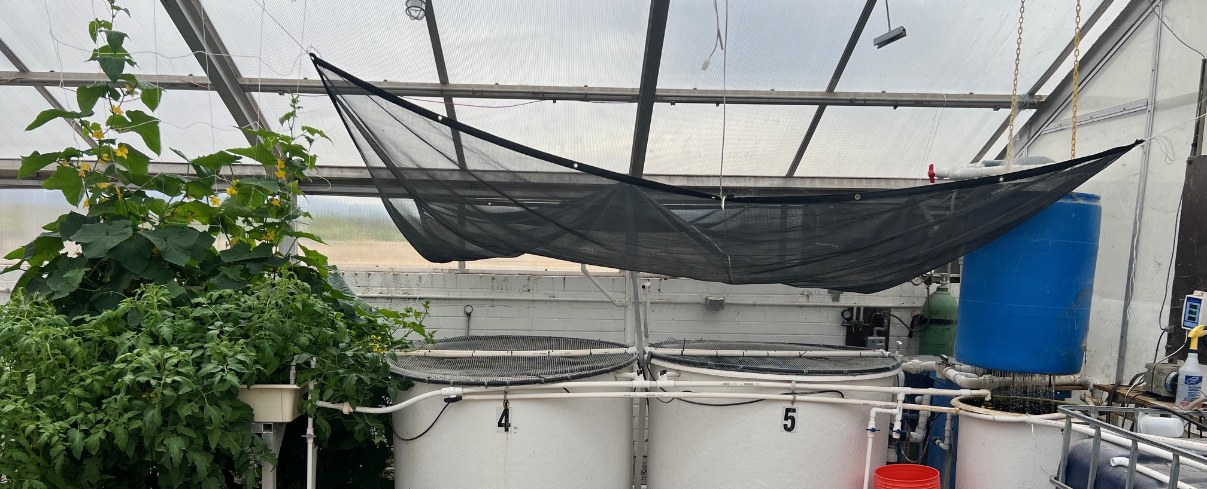
Aquaponics is Not Just a Production System
It is a platform for:
Circular Nutrient Management
Biological Innovation
Waste Valorization
New Revenue Streams

Slide 5
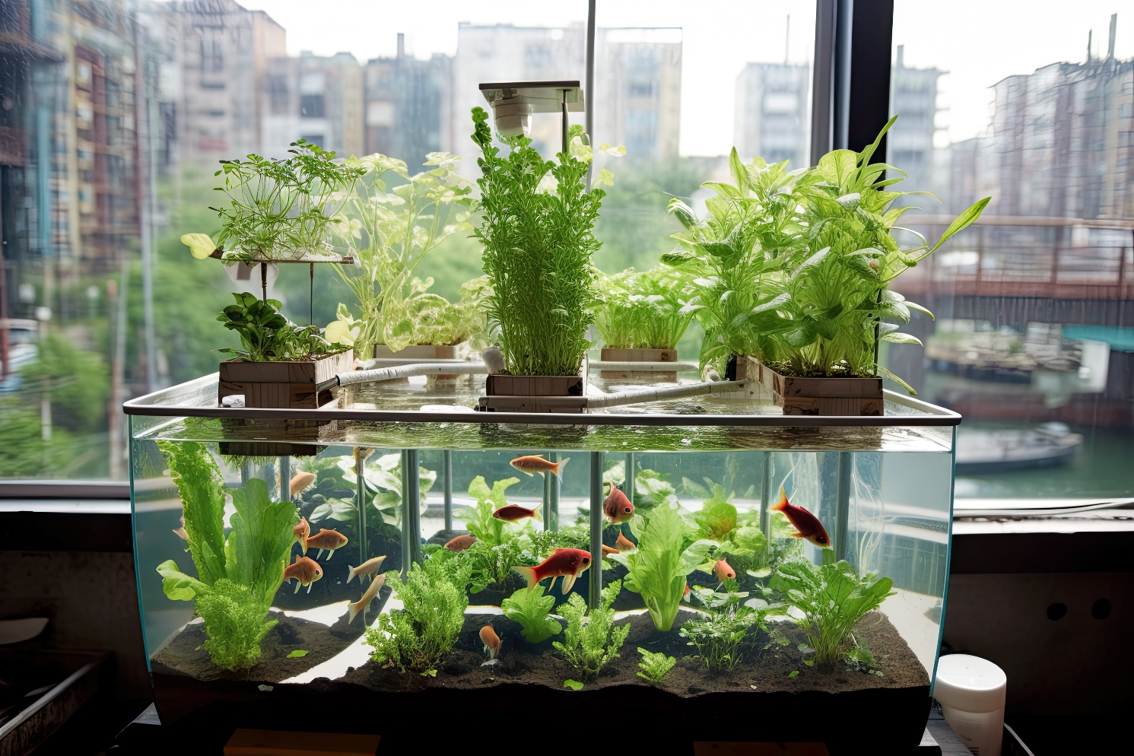

Why does it work?

Slide 6
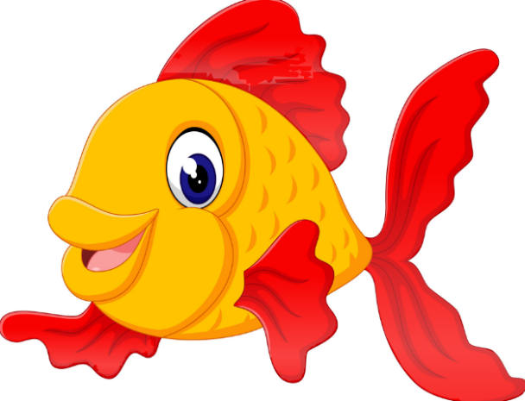
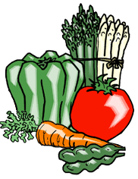
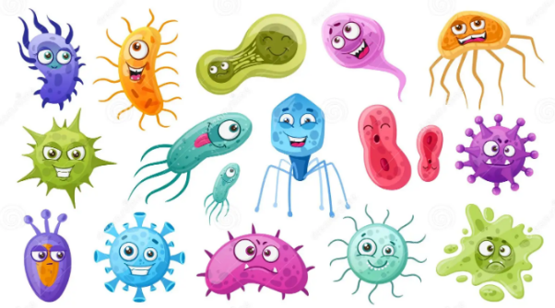
Feces + NH₃
Plants filter water that is returned to the fish
Fish produce wastes
The Aquaponic Cycle
Microbes convert wastes to fertilizer (nutrients) for plants
Nutrient Rich Effluent

Slide 7
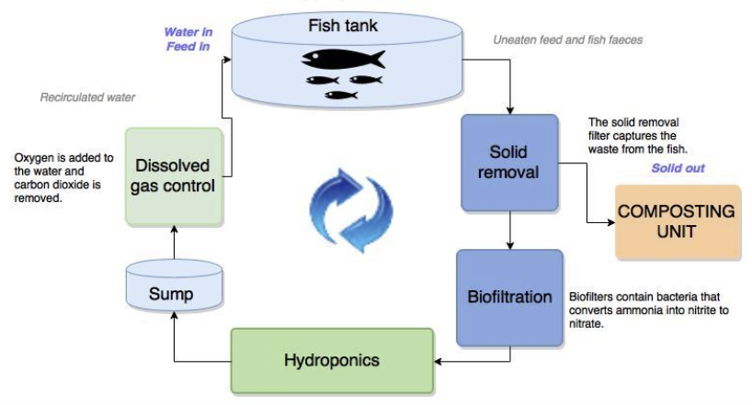
Aquaponics Process Diagram
+Alkalinity
Photo Credit: Ragnheidur Thorarinsdottir
*Composting Unit = Sludge Digestion

Slide 8
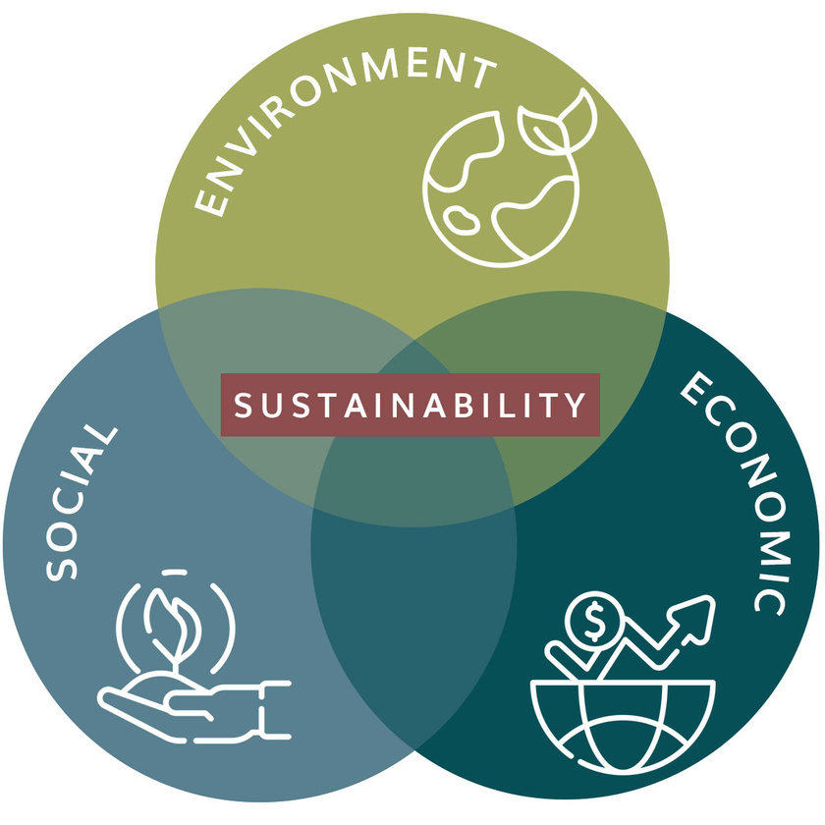
Why is Aquaponics Considered Sustainable?
Resource use efficiency
Free nutrients through fish feed – majority of salts don’t have to be mined or produced in a lab
Uses less water than soil-based or hydroponic plant production
No runoff and limited discharge into environment
Even the best RAS discharges significant amounts of effluent daily
Organic plant production possible
Reduced chemical input
Healthier Product
Local and year-round production

Slide 9
Where Aquaponics is Truly Sustainable (and where it isn’t yet)
Strengths
Limitations
Water Reuse
Nutrient Recovery from Waste Streams
Reduced Synthetic Fertilizer Dependence
Potential Circularity
Energy Use (pumps, heating, lighting)
Capital Intensive
Fish Feed Sourcing
Nutrient Imbalances
Notes:
So aquaponics isn’t automatically sustainable.

Slide 10
Closing the Loop in Aquaponics
Feed Input (External)
Fish
Waste (Solids + Dissolved Nutrients)
Reuse Pathways
Plants (Nutrient Uptake)
Solids/Effluent Streams
Where Innovation Happens
Nutrient Factory
(Natural Process)
Often Discharged
Lost if not mineralized
Notes:
The next step is figuring out how we actually close the loop. Most aquaponics systems are not circular, they’re just less wasteful.

Slide 11
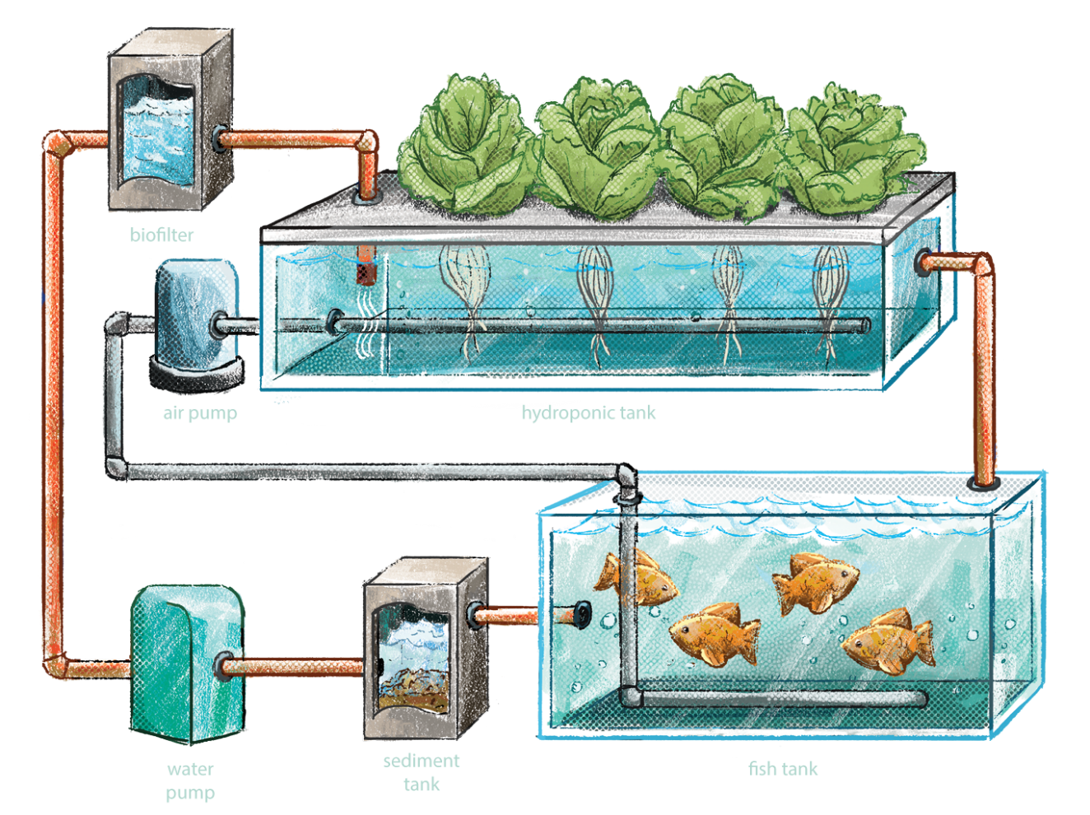
Why Use Aquaponics?

Slide 12

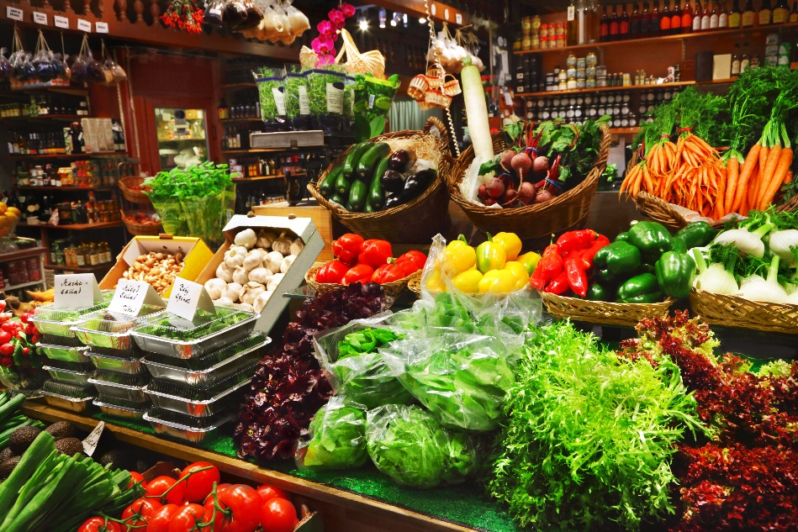
Shifting Trends in food markets
Consumers are increasingly looking for ways to reduce their environmental impact – creating increased niche for sustainably grown foods
Increased demand for locally grown foods – perceived as fresher and tastier
Demand for organic foods – has been increasing at a steady rate since 2012

Slide 13
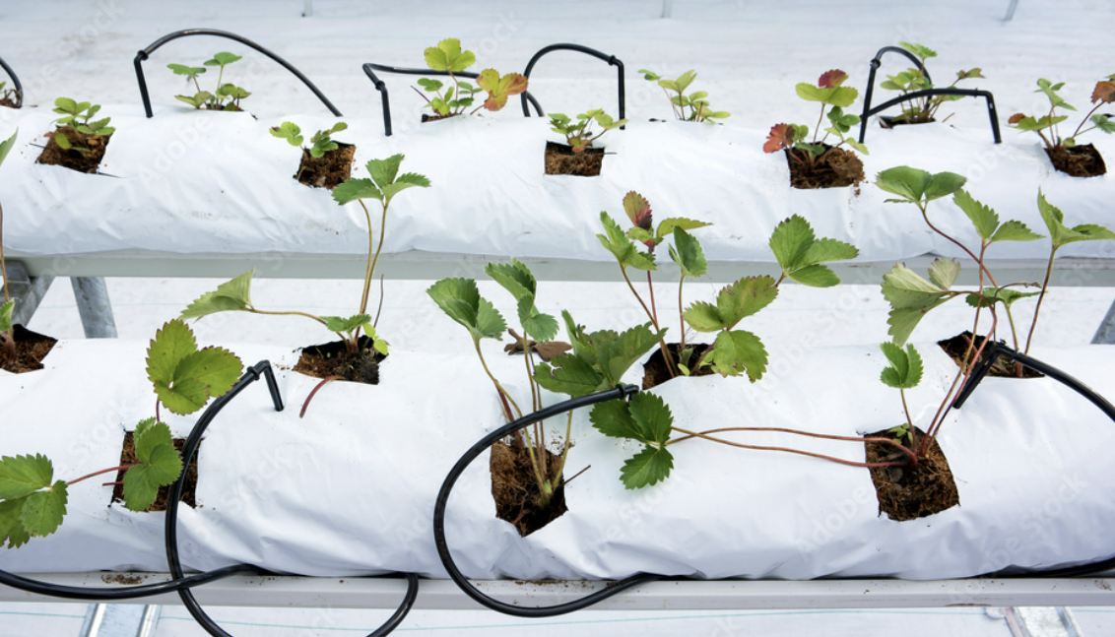
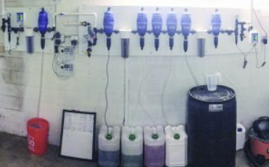
Key Advantages of Aquaponics
Water Efficiency (30%-60% less water than hydroponics)
Reduces Synthetic Fertilizer Use
Integrated Production
Potential Microbiome Benefits
Year-round production

Slide 14
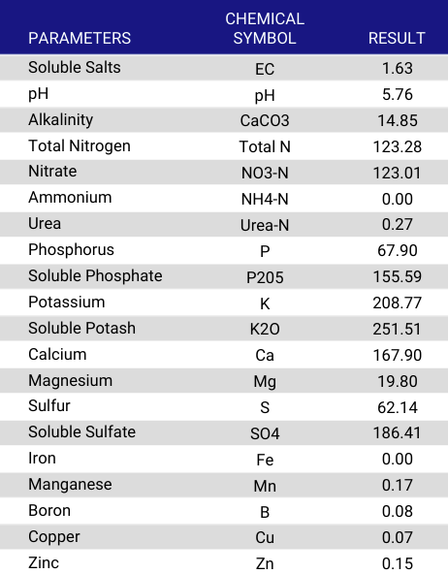
Advantages of Aquaponics
Micros
Provides nutrient rich effluent to hydroponically grown plants (no fertilizers needed)
Nutrients considered organic
Adequate nutrients available when allowed to build up in aquaculture system

Slide 15
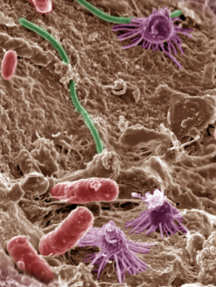
Where Aquaponics has a Unique Advantage
Microbiome driven plant performance (Diverse and complex bacterial load in)
Nutrient recycling vs hydroponics
Waste >> Revenue Potential

Slide 16
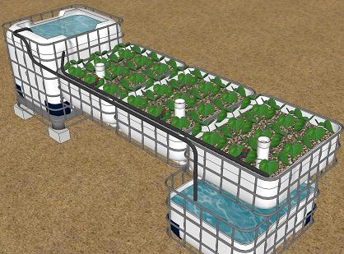
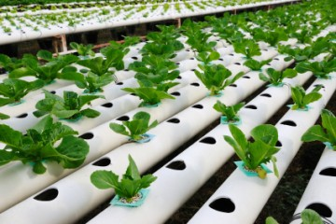
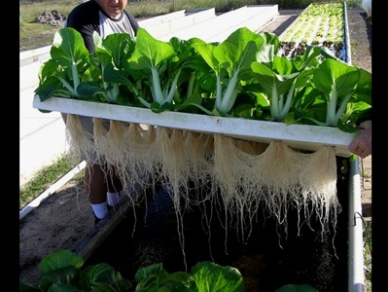
Three Traditional Aquaponic System Types
Media Bed System
Can be Flood and Drain or Ebb and Flow system, flow through or standing water level
Deep Water Culture (DWC) or Raft System
Nutrient Film Technique (NFT)

Slide 17
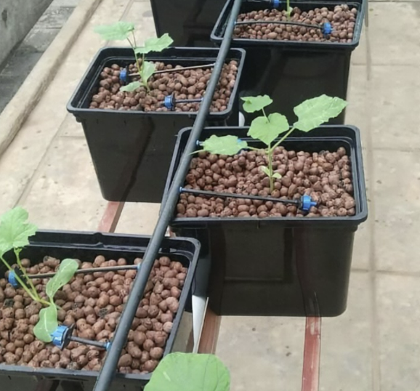
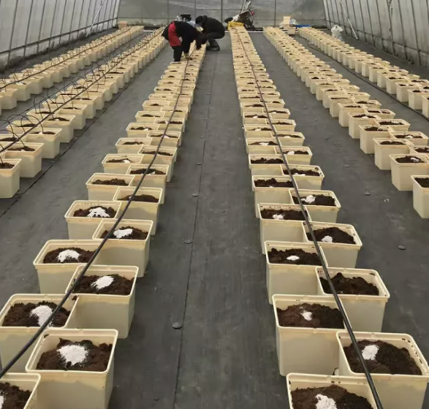
Dutch Buckets/Bato Buckets
Most common in commercial aquaponics for fruited plants

Slide 18

How Do We Make Aquaponics Work in CEA?
Decoupling
Nutrient Control
Crop Selection

Slide 19
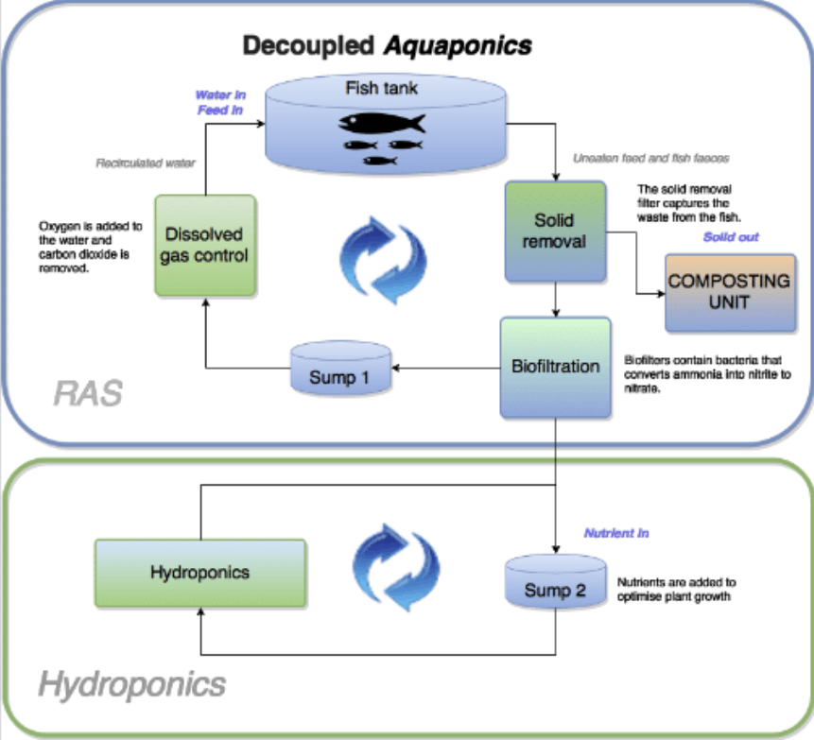
Decouple the System to optimize plant production
Photo Credit: Ragnheidur Thorarinsdottir

Slide 20
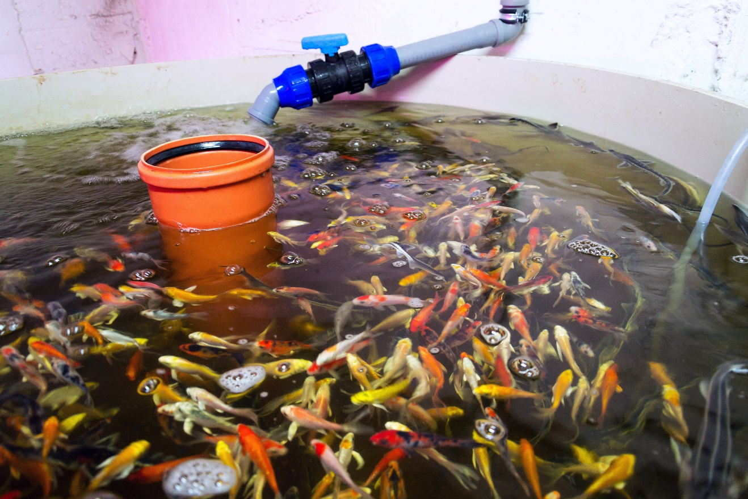
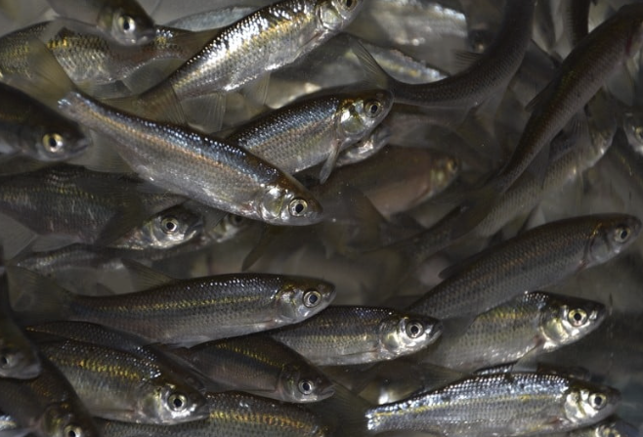
Fish Don’t Have to be for Food
Also, for aesthetics (ornamentals), baitfish or just for nutrients!

Slide 21
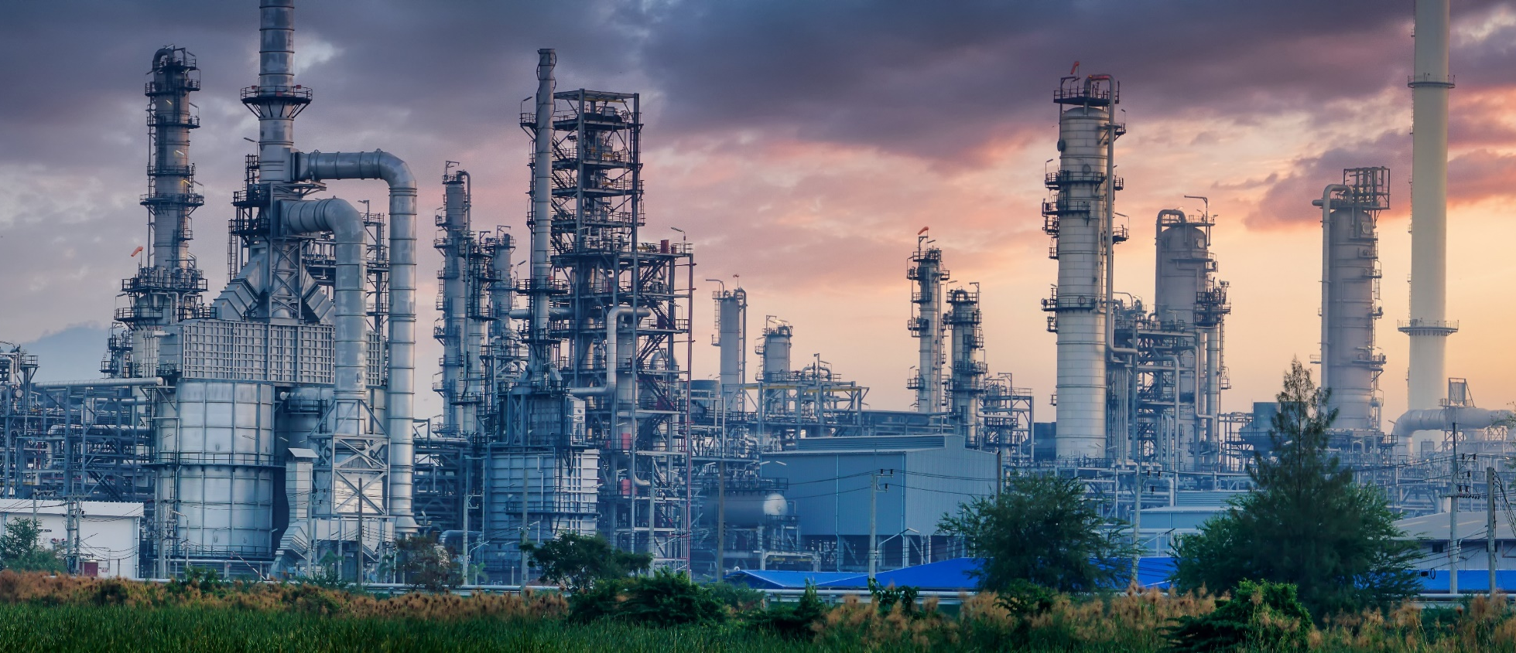
Aquaponics = Nutrient Factory
Optimize aquaculture system to produce the best nutrient concentration for plants you are growing
Allow pH to run low (6.0-6.5)
Supplement alkalinity and boost pH with potassium bicarbonate and calcium carbonate
Made possible through mineralization of fish waste
Notes:
This is how we close the loop

Slide 22
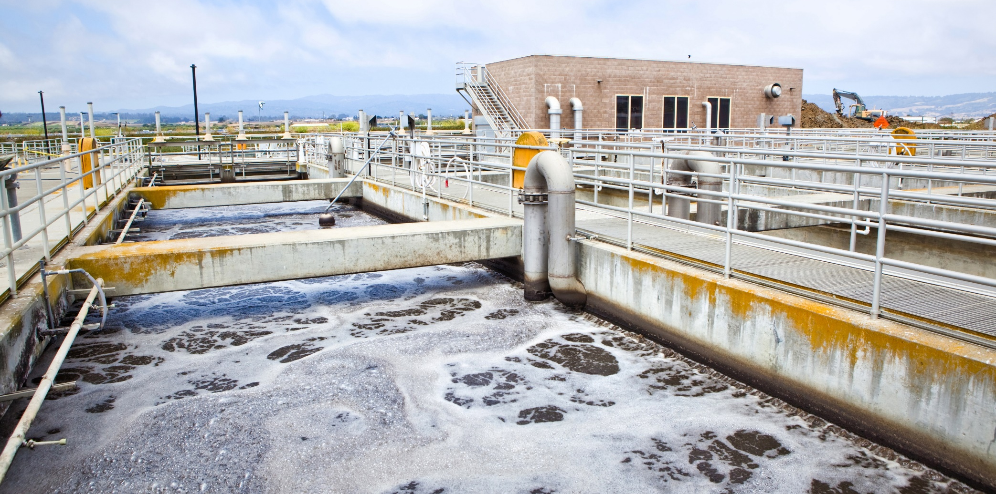
Mineralization of Sludge
Crucial Step!
Extraction of nutrients from solids removed from aquaculture system
Aerobic bacterial action like aeration basins in wastewater treatment plants

Slide 23
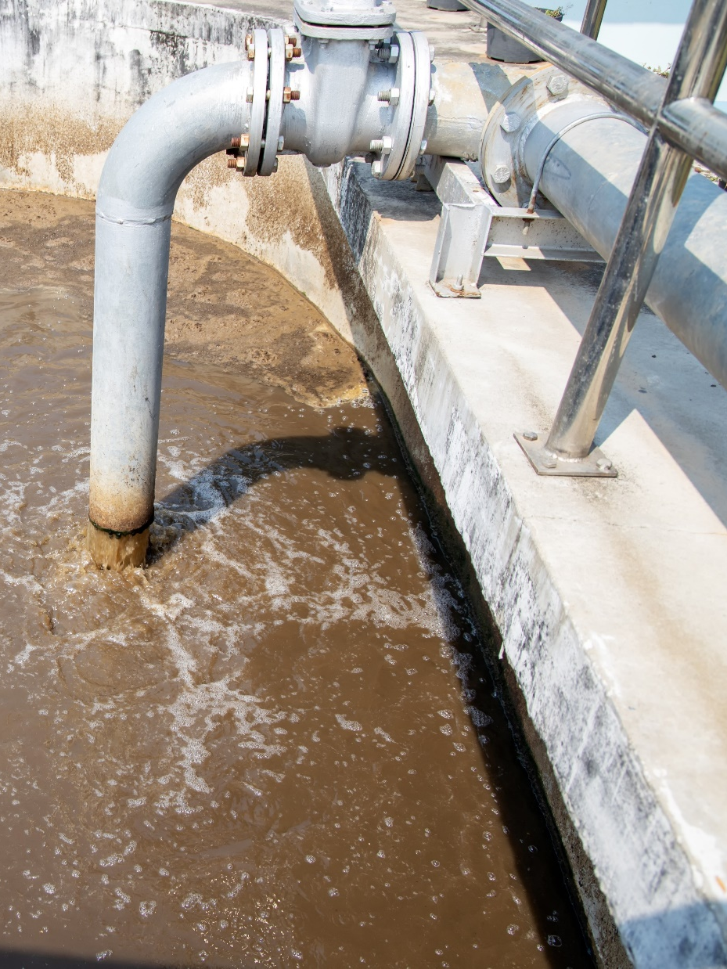
Aerobic Mineralization
Process whereby solid fish waste (poop, uneaten feed) is broken down and converted to mineral forms that can be utilized by plants as nutrients
Aerobic (preferred) – relies on bacteria (and other microbes) to break down the solids through mixing and aeration
Faster degradation of organic solids
Typically, 4 weeks total retention time needed (often in 2 stages)
Notes:
Nutrients in solids are unavailable to plants so must be broken down (mineralized)

Slide 24
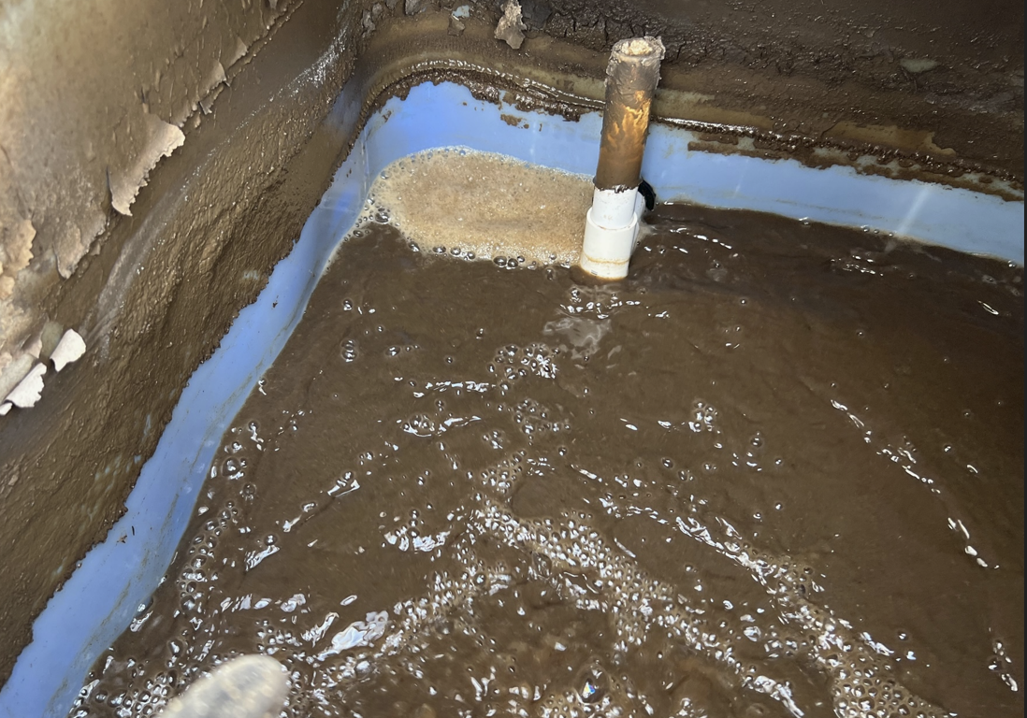
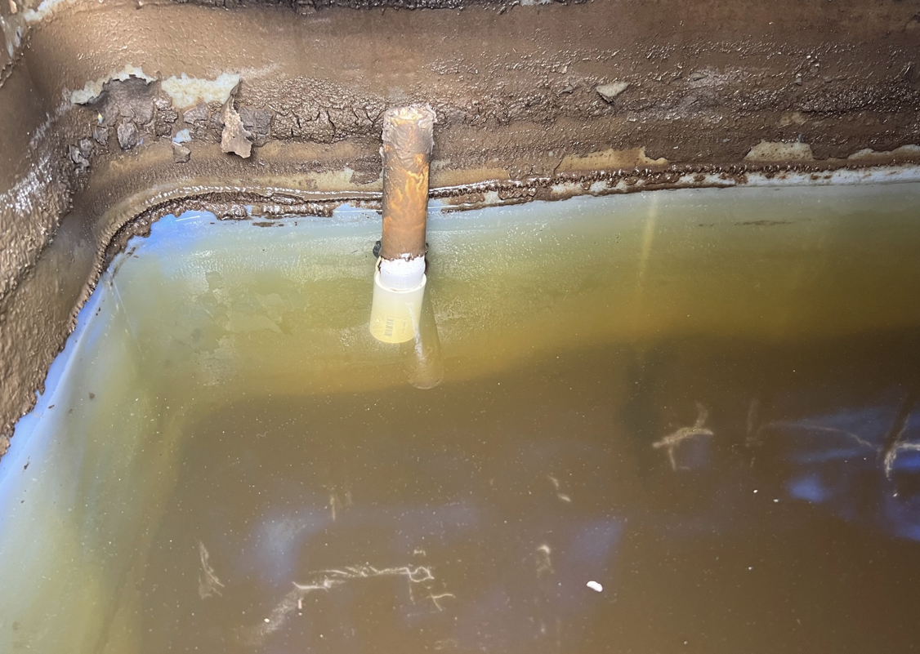
Sludge Tank While Aerated Vs After Settling
*Typically >1 hour required for settling, then 2nd stage mineralization supernatant added directly back to RAS

Slide 25

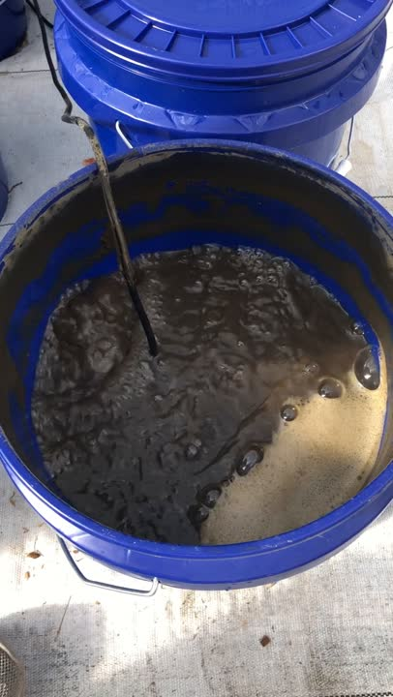
Mineralization Experiment Showed
Phosphate (PO₄³⁻) = 16.5% increase after 2 weeks; 45.0% increase after 4 weeks
Potassium (K⁺) = 20.4% increase after 2 weeks; 31.5% increase after 4 weeks
Calcium (Ca²⁺)= 25.5% increase after 2 weeks; 59.4% increase after 4 weeks
Magnesium (Mg²⁺) = 14.6% increase after 2 weeks; 42.1% increase after 4 week
Boron (B) = 30.0% increase after 2 weeks; 90% increase after 4 weeks
Manganese (Mn) = 41.7% increase after 2 weeks; 96.3% increase after 4 weeks

Slide 26
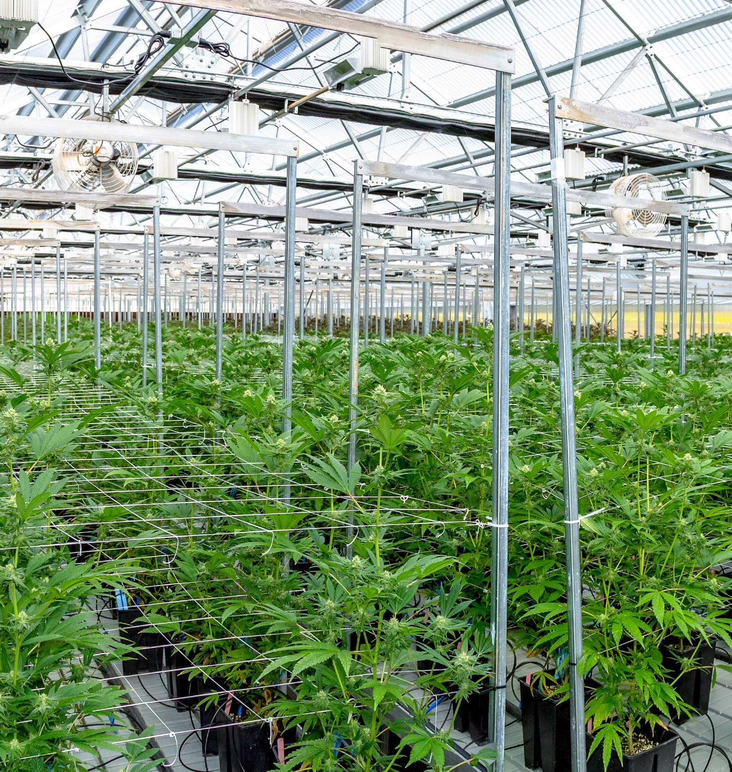
Adding Mineralized Water Back into RAS Allows you to Build System Nutrients over Time
Circularity
Estimate running system for 3 months minimum to achieve desired nutrient gradients

Slide 27
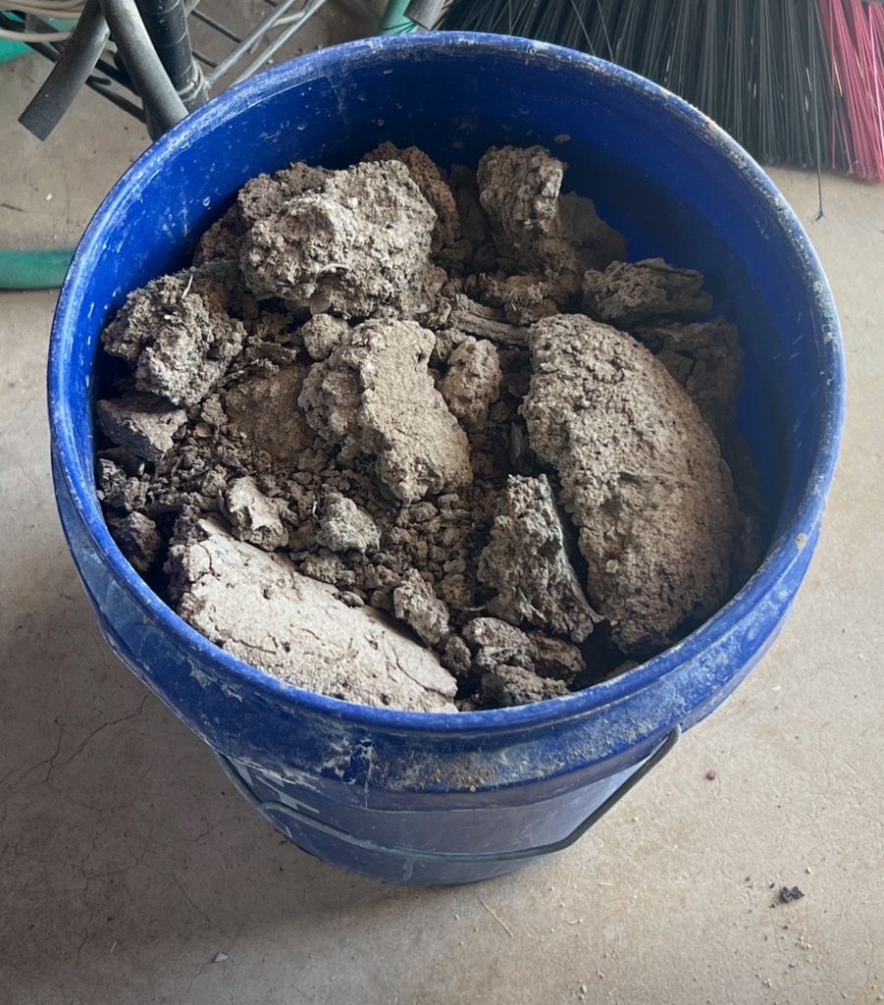
What about Aquaculture Biosolid Production
Produced through dehydrating incomplete mineralized sludge
Why is it incomplete?
Strong Organic bonds
Stabilized solids can build up over time in a mineralization system
Eventually removed and dewatered
Sun drying, air drying (time), geotextile bags
Benefit over non-stabilized fish waste solids
Stable
No smell
Promotes controlled nutrient release in soil and reduced oxygen demand
Improves soil structure

Slide 28
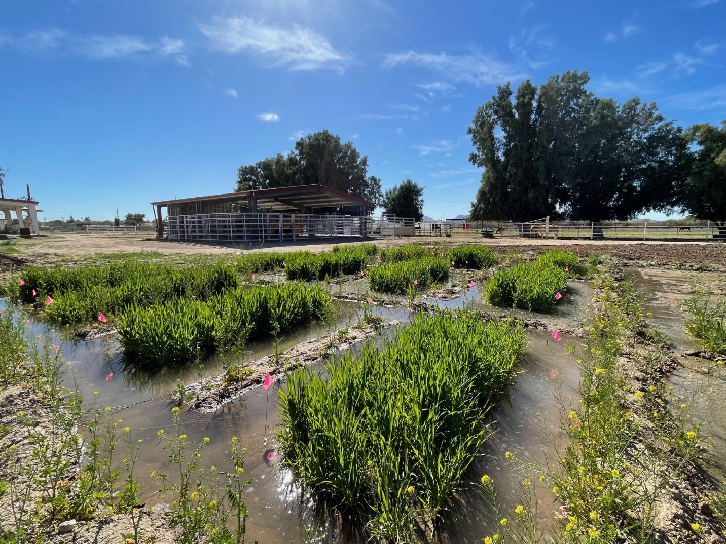
Aquaculture Biosolids Experiment
Demonstrate efficacy of aquaculture biosolids for growing Durum Wheat
Compared to granular fertilizer and dairy manure
Examine soil nutrient content, moisture content, yield, protein and soil productivity

Slide 29
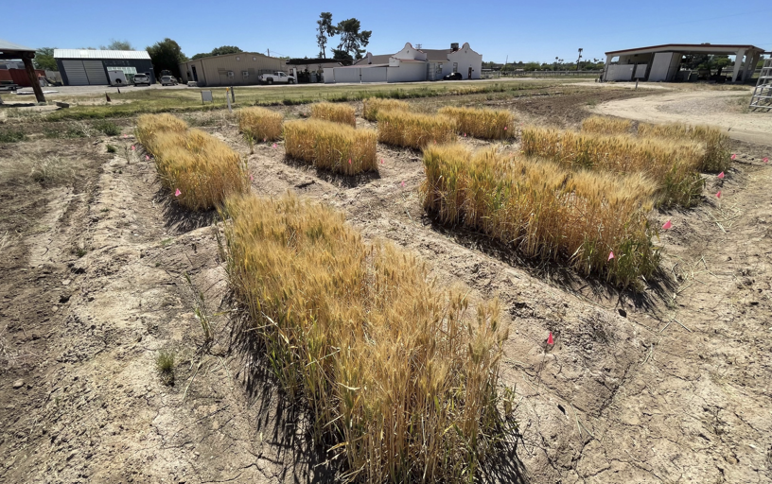
Aquaculture Biosolid Performance
Comparable Yields to other treatments but higher protein content
Improved soil health through addition of carbon, sulfur and microbes
More research needed, but results were promising
Will be important to assess the economic feasibility of attaining and using large quantities on a commercial scale

Slide 30
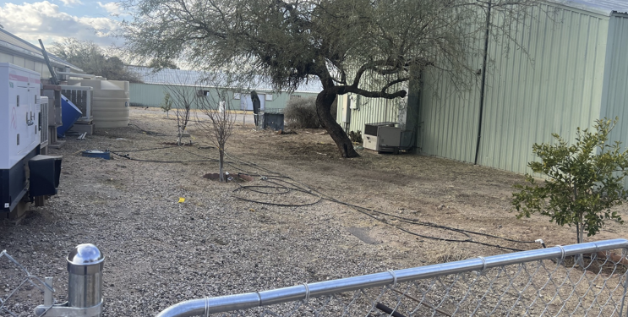
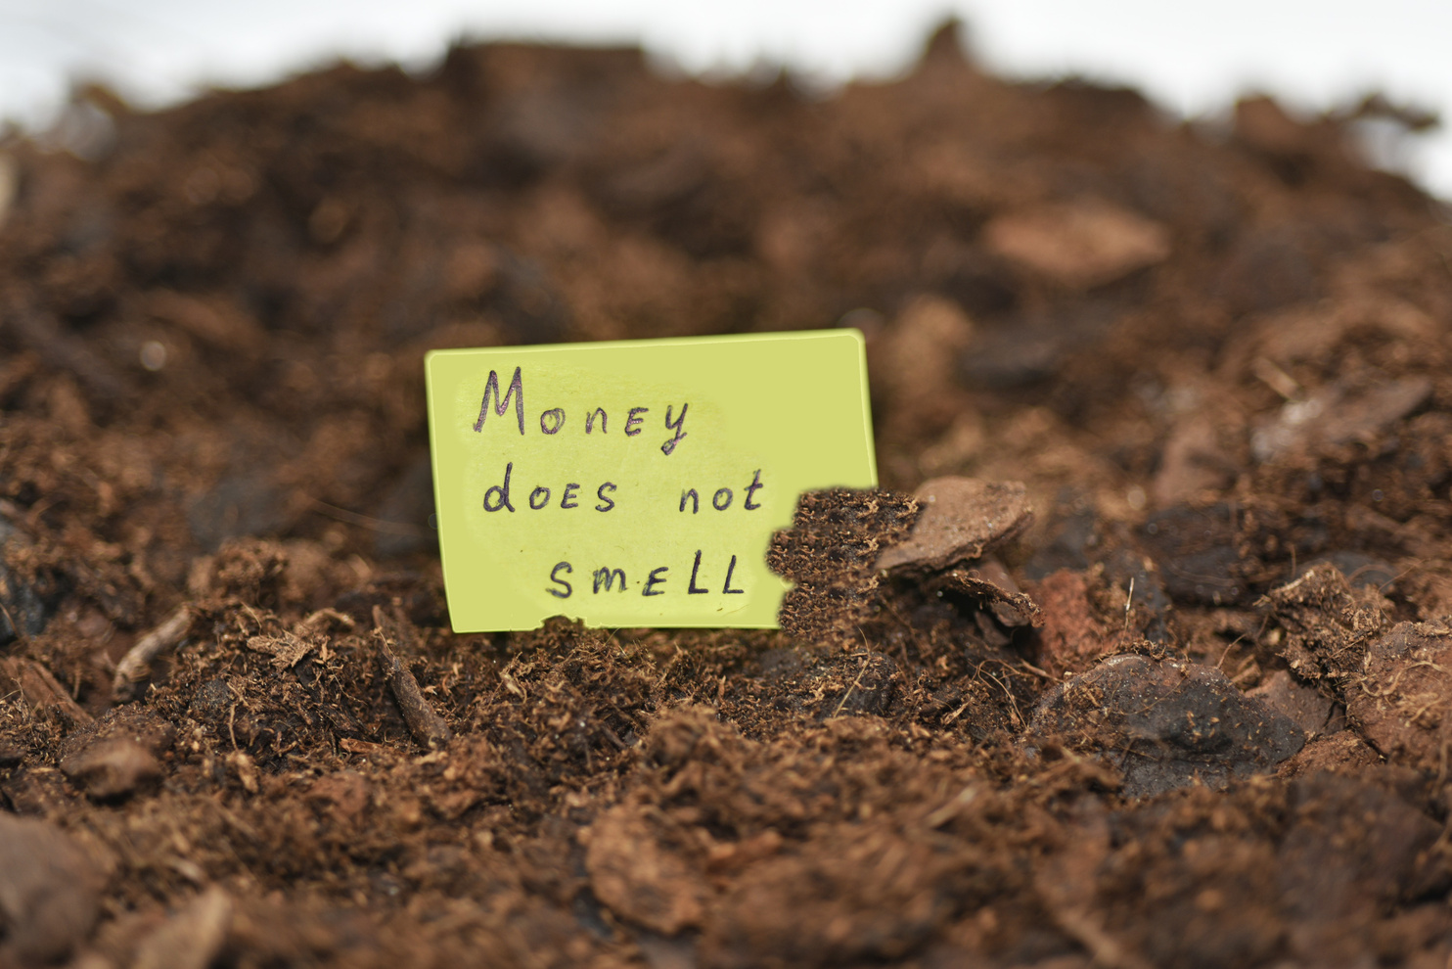
How We Improve Sustainability (and Profitability)
Effluent Reuse
External irrigation to fruit trees or other crops or sell to hydroponic growers
Biosolids
Collection of stabilized biosolids for use in land-based agriculture or gardens
Integration

Slide 31
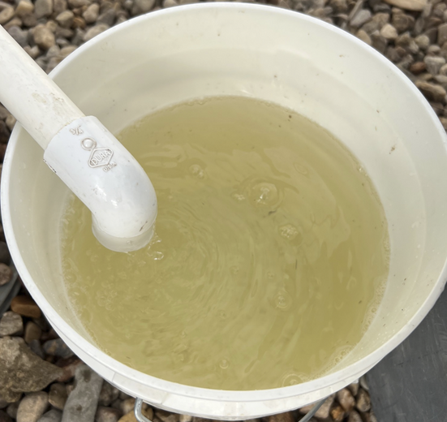
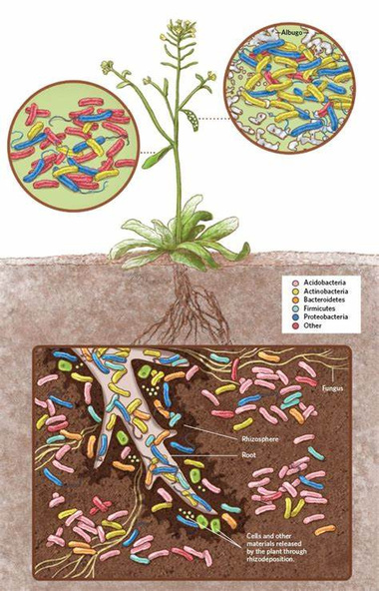
Effluent Sales
Typically, mineralized water depending on concentration of system water
Have been able to consistently show that 10% effluent can reduce water usage in hydroponic hemp production and potentially improve bud quality through root microbial interactions
It isn’t just the nutrients!
Effluent from Mineralized Solids contains good microbes for inoculating root zones in hydroponic systems
$75/gallon in niche high-value systems
i.e. Cannabis

Slide 32
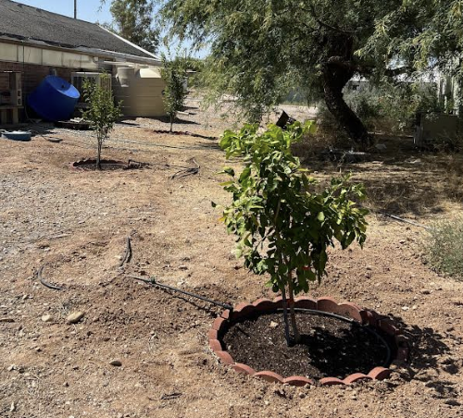
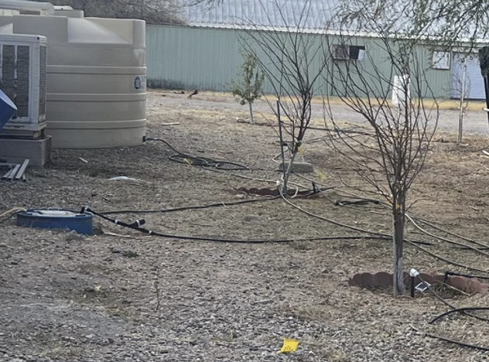
Sustainable Fruit Orchard Project
Demonstration of how trees can be grown more sustainably with effluent and biosolids from aquaculture systems
Smart irrigation + Rainwater harvesting

Slide 33
The Microbiome Advantage
This is what hydroponics lacks
This is where innovation is happening
Improves nutrient uptake and plant resilience

Slide 34
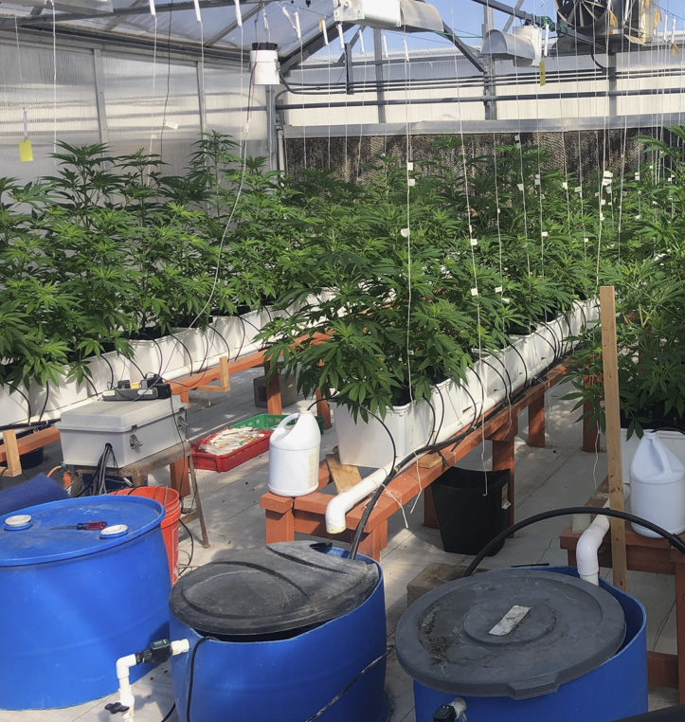
Active Nutrient Management in Aquaponics
Allows for RAS to achieve adequate nutrient levels for high-nutrient demand crops
Examined: Flow through vs recirculating vs hybrid systems vs hydroponics
Flow through and hybrid systems had Equivalent yields to hydroponic control
Water Savings (~60%)
Dutch Bucket Cannabis

Slide 35
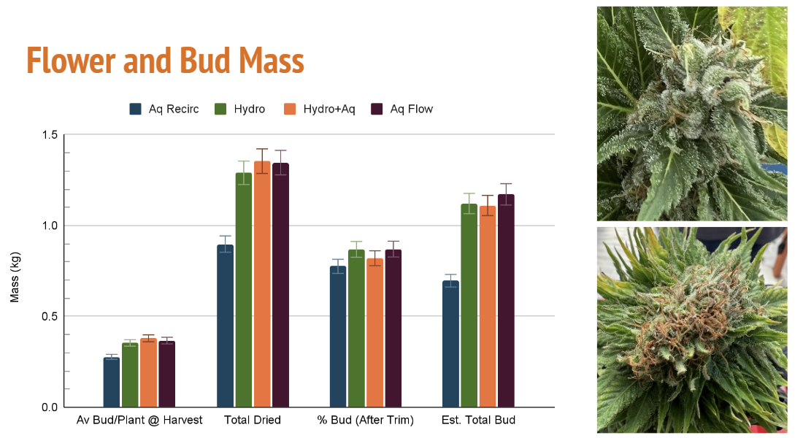
*Attribute success to root microbiome introduced from aquaculture effluent

Slide 36
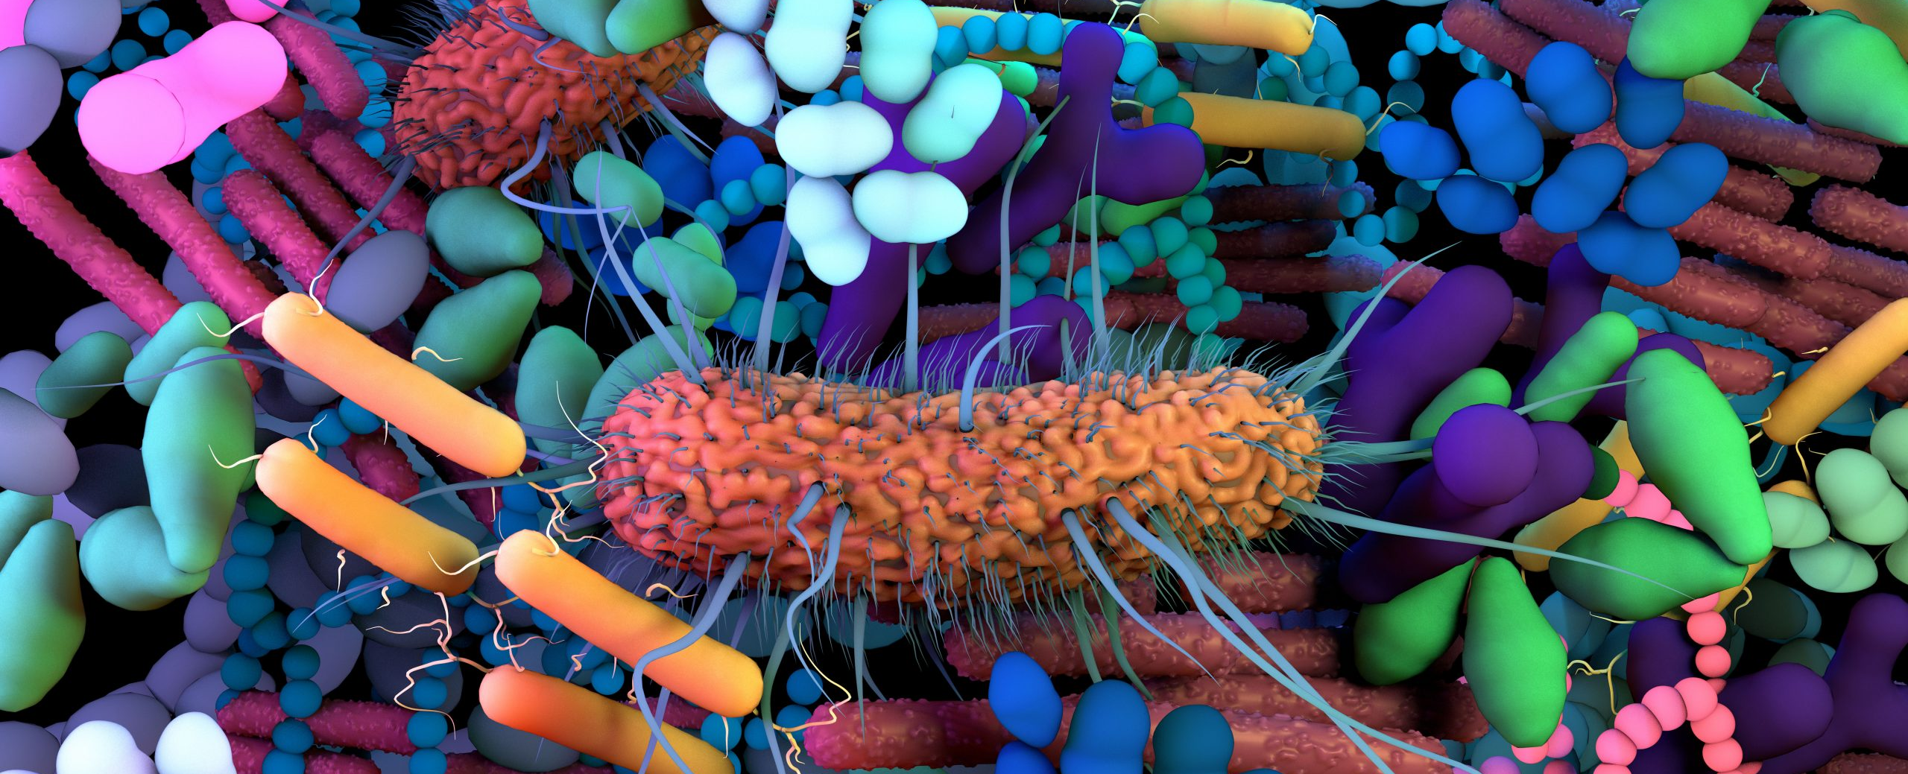
How Does Introducing a Microbiome Benefit the Plants?
Phytohormones - Beneficial microbes (PGPMs) synthesize phytohormones like auxins and gibberellins, which stimulate root development and improve nutrient absorption
Enhancement of Root Exudates – Chemical signaling directs microbes to make things plants want or to release compounds that recruit specific microbes
Phosphorous Solubilization – Specific bacteria convert insoluble phosphorus to soluble forms, increasing solubility to plants

Slide 37

How does Sustainability Drive Profits?
People will pay more for eco-friendly products
Deeper brand loyalty – repeat customers
Reducing water, nutrient and energy costs can lower operational costs and improve profit margins
Additional revenue streams through waste products
Employee engagement and retention
Younger people want to work for companies with strong commitments to sustainability
Long-term stability

Slide 38

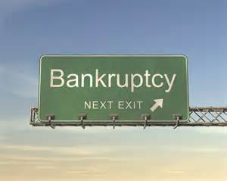
Currently only a few Commercially Viable Aquaponic Businesses Exist…but why?

Slide 39
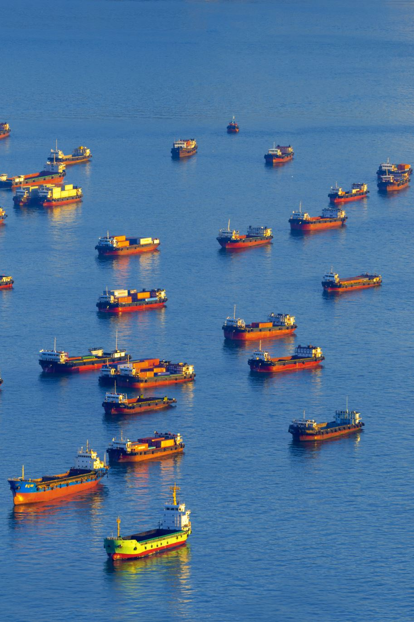
Reasons Why Many Commercial Aquaponics Farms Fail?
Focus too heavily on fish production
High capital and Operating costs
Poorly designed systems
Marketing issues
Underselling product, not understanding market
Poor nutrient management
Increased complexity
Lack of necessary skills to manage and operate

Slide 40

Large Aquaponics Farms that Have Gone out of Business in Recent Years
The FishFarmers (USA) - Based in Florida, The FishFarmers was one of the largest aquaponic operations in the country, but they shut down in the mid-2010s. They faced financial difficulties due to low demand for their products and issues with scaling their aquaponics technology.
Aquaponics USA (USA) - Located in Florida, Aquaponics USA was one of the prominent early players in the industry. The company shut down operations in the 2010s after struggling with financial sustainability, production inefficiencies, and market adoption.
Gotham Greens (USA) - While Gotham Greens, an urban farming operation that uses hydroponics, remains active, it faced difficulties with its aquaponic operations. Their original aquaponics facility in New York City had to scale back in the early 2010s due to the high cost of operation, and the focus shifted away from aquaponics in favor of other hydroponic techniques.
Aqua Vita Farms (USA) - Based in California, Aqua Vita Farms was an ambitious aquaponics project that ultimately went out of business due to financial difficulties and inconsistent market demand. Their attempt to create a large-scale, commercial aquaponics operation proved unsustainable.
Dayton Valley Aquaponics (USA) - This large-scale operation outside of Reno Nevada shut down in 2021 due to shifting markets during the pandemic, high operational costs and scaling difficulties. They utilized a coupled aquaponics system.
Green Sky Growers (USA) - Green Sky Growers in Florida, which operated large-scale aquaponic systems, faced financial challenges and eventually shut down in the 2010s. Their inability to scale profitability, along with technical and logistical issues, contributed to the closure.

Slide 41
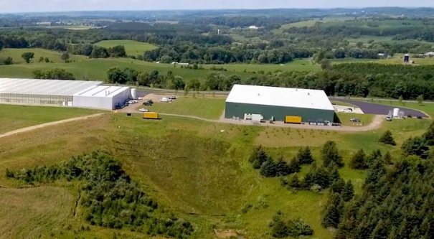

Superior Fresh Aquaponics
Largest aquaponics farm in the world
Considered the Gold Standard for large-scale aquaponics operations
1st landlocked Atlantic salmon farm in the U.S. using RAS technologies
FCR = 1.1
(FCR = Feed Conversion Ratio)

Slide 42

Superior Fresh Aquaponics
Grow leafy greens, herbs
3 Million lbs. per year
State of the art greenhouses
Supplemental lighting for winter
Environmental parameters monitored and controlled

Slide 43


Superior Fresh Aquaponics

Slide 44

Recently closed aquaponics operations – Expanding land-based salmon operations

Slide 45
The Aquaponics Paradigm
Single greenhouse with leafy greens and tilapia has been the aquaponic model for decades
Coupled system have been the norm where growers compromise on environmental variables to appease both fish and plants (I.e. pH =7)
Problems:
Difficult to compete with commodities market on leafy greens and other low-value crops
Market for live fish is limited
Not scalable
High operating and startup costs
The Paradigm Needs to Shift!
Notes:
18

Slide 46

New Aquaponics Paradigm
Hybrid models – Combine with traditional hydroponics
RAS = Nutrient Factory
Grow high-value crops (and diversify) – premium pricing (more different products per customer)
Automation and AI monitoring –advanced nutrient sensors can improve efficiency
Local and Specialty Markets – sell to restaurants, specialty markets, direct to consumers
Notes:
18

Slide 47

Capable of saving even more water
Good solids filtration paramount to prevent clogging
Research forthcoming!

Slide 48

Aeroponics Cannabis

Slide 49


Other Innovative Strategies and Optimization Techniques
Decoupling is a given
Development of aquaponic-specific fish feeds
Currently exploring unique insect larvae for which we can control diets to increase various nutrients (i.e. phosphorous, iron, calcium, potassium)
Real-time monitoring of nutrient levels with automated addition of nutrients to maintain optimal balance

Slide 50

Future Outlooks
Currently exploring Microbiome and how it can be transferred into hydroponic operations
Performing research on improving sludge digestion to increase nutrient content of Aquaponics effluent
In process of developing insect-based aquaponic feed to promote more efficient plant growth

Slide 51





Special Thanks to My Awesome Team of Students!
Interns
Ashley Jeunke
Jimmy McNeil
Martin Rodriguez
Angelo Mauro
Jose Gallego
Gia DeYoung
Taylor McCoy
Josiah Jackson
Justin Smith
Reese Arbitelle
David Dong
Desmond Traynor
Jackson Schutter
Tatyana Wong
Curry Curry
LJ Gusky
Kennedy McEnany
Ben Hunt
Gracie Reinholz
Graduate Students
Kate Stalkfleet
Jessie Johnson
Marcangelo Maisto
Max Smith
Lauren Stevenson
Ryan Wheaton
Rachel Nehrmeyer

Slide 52



Questions?

