Slide 1
Growers of the future
Connecting nature and technology
Notes:
Remote access:
How to access IIVO on mobile phone or iPad?
Show multifactor authentication
Show how to make use of impersonated user? → dat je met verschillende mailadressen/ accounts inlogt op feitelijk hetzelfde account maar daardoor dus wel logging van activiteiten van de verschillende personen hebt.

Slide 2
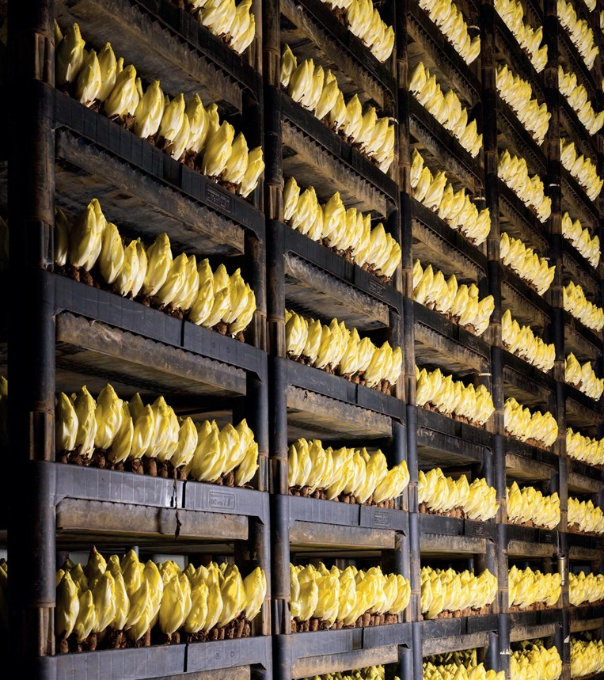
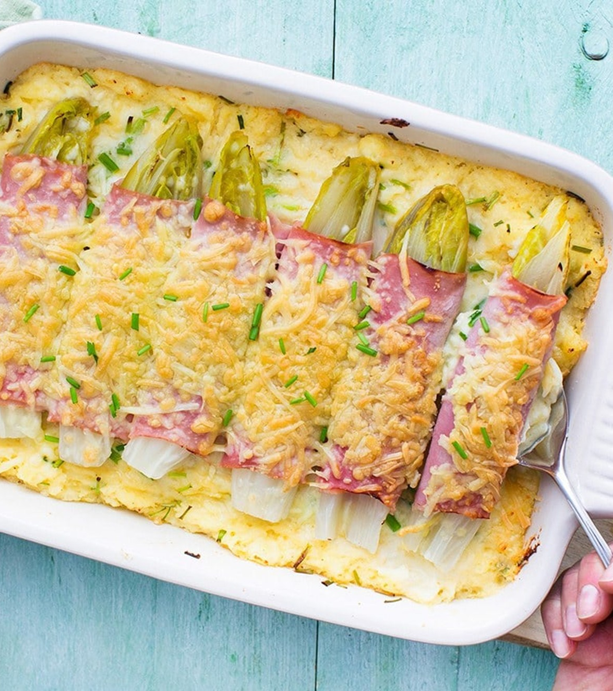
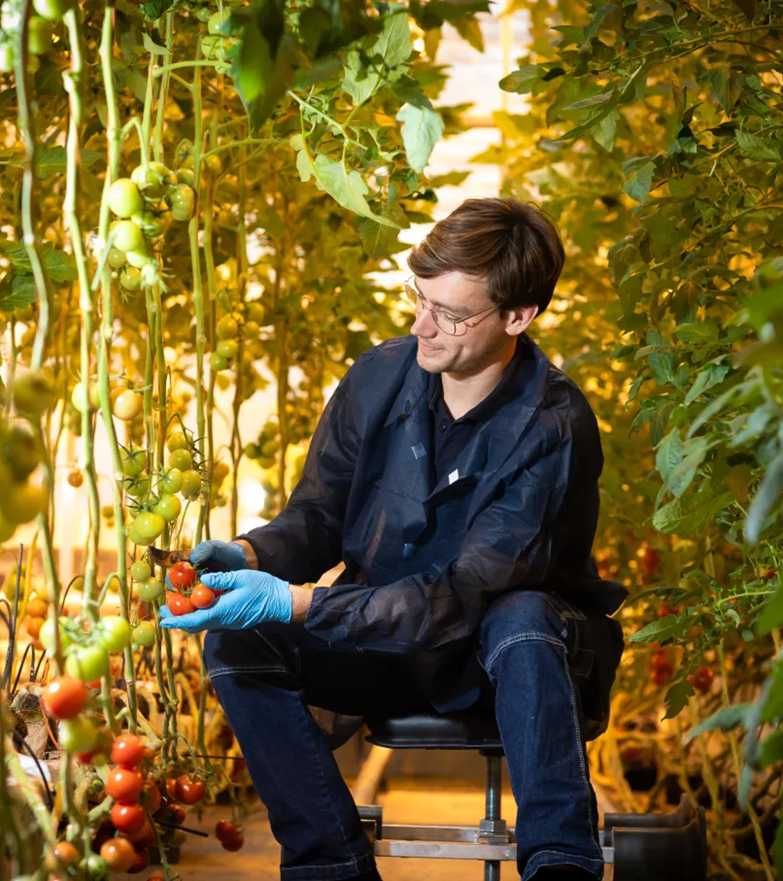
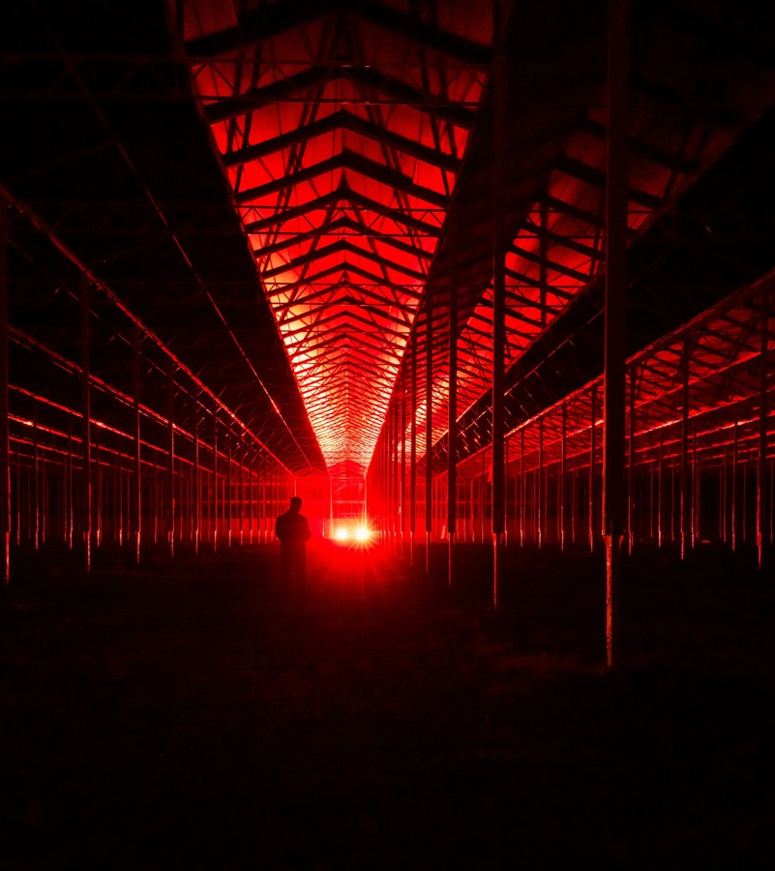
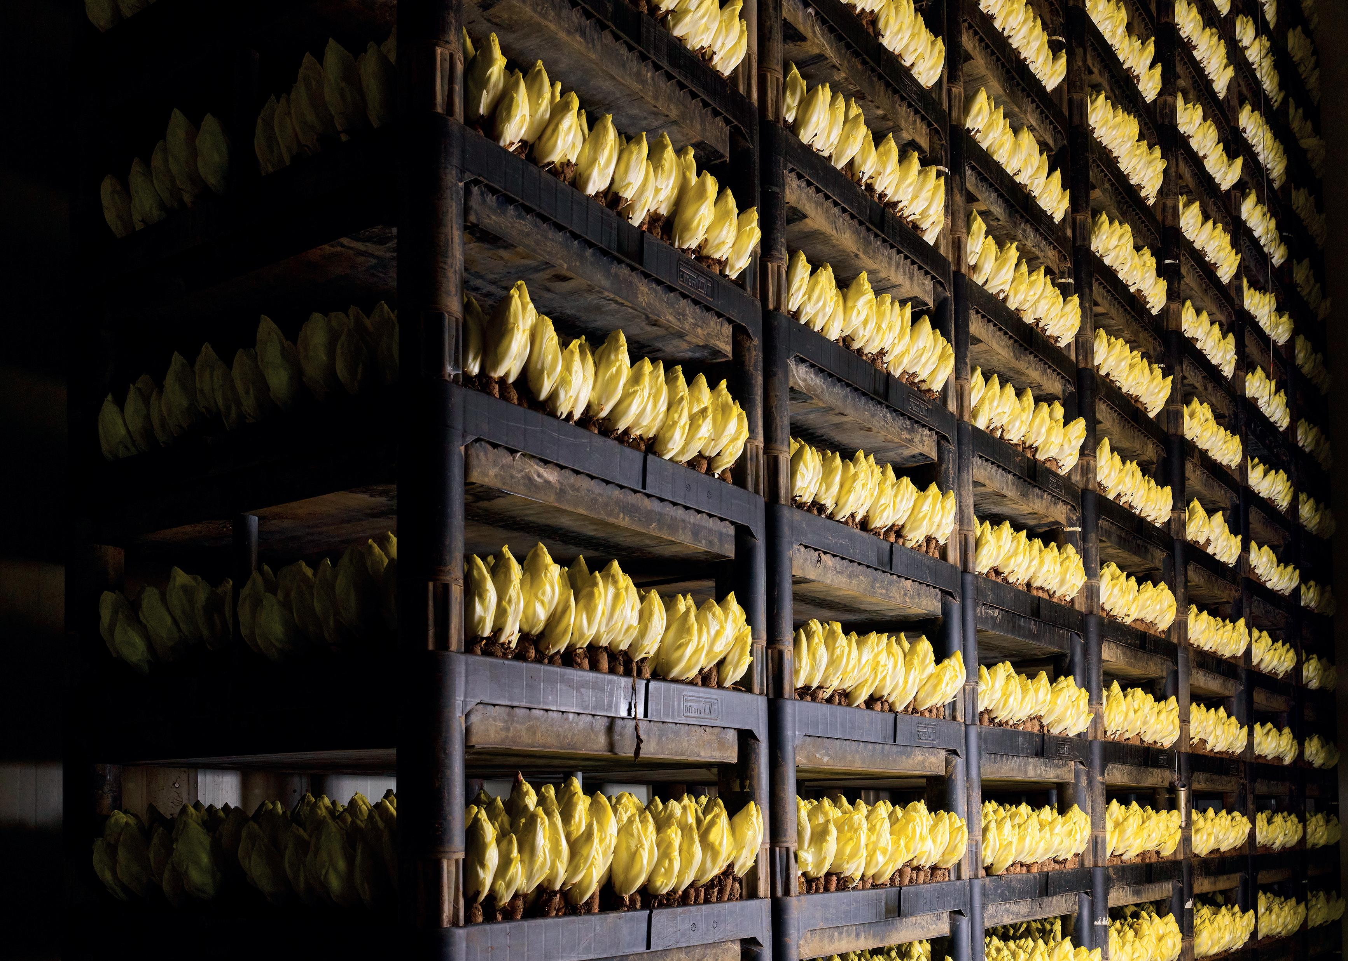

Who am I?
Grew up on a chicory farm
Msc Plant sciences, Wageningen university
Hoogendoorn growth Management

Slide 3
Agenda for today
Introduction video
Autonomous Greenhouse Challenge (AGC)
Plant Empowerment principles
Sensor toolkit for in the greenhouse
Intelligent Algorithms
Plan Do Check Act

Slide 4
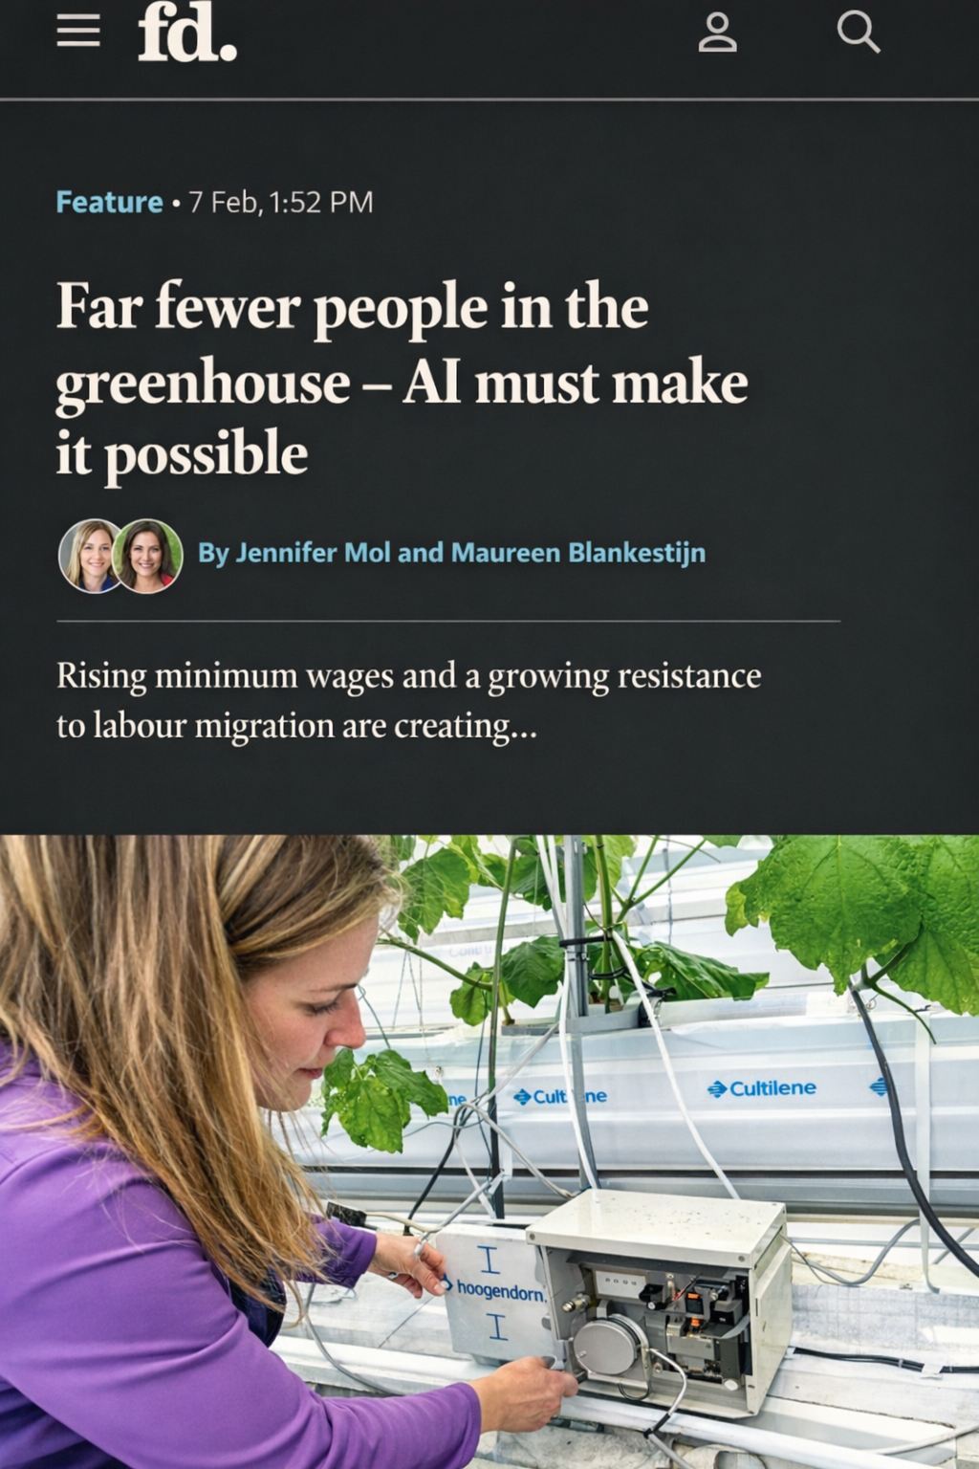
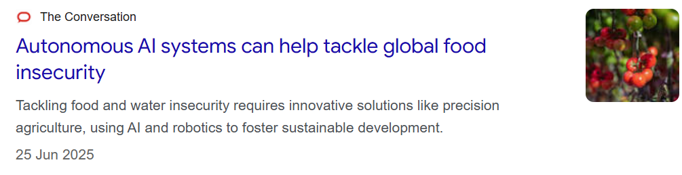
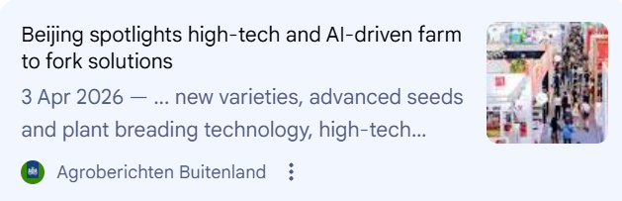
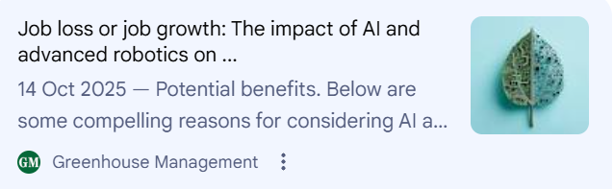
The future of growing crops is datA driven growing
Is AI the solution for everything?

Slide 5

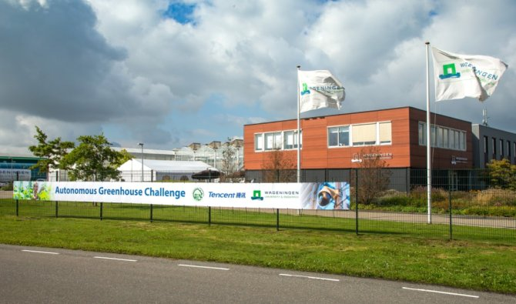
Autonomous greenhouse challenge
In 2020 Hoogendoorn competed in the Autonomous Greenhouse Challenge where they grew Cherry tomatoes at Wageningen University, against six other teams
Rules: Teams were physically not allowed in the greenhouse
Target: Maximizing net profit (yield x quality - raw material/energy costs) during a six-month growing period
Judging: 50% Net profit: Highest production and quality at the lowest costs . 30% AI strategy and Innovation: The robustness, scalability, and novelty of the algorithm used.
. 20% Sustainability: Efficient use of energy, water and CO₂
Comparison: There was one reference grower who was allowed in the . greenhouse against who the teams competed

Slide 6
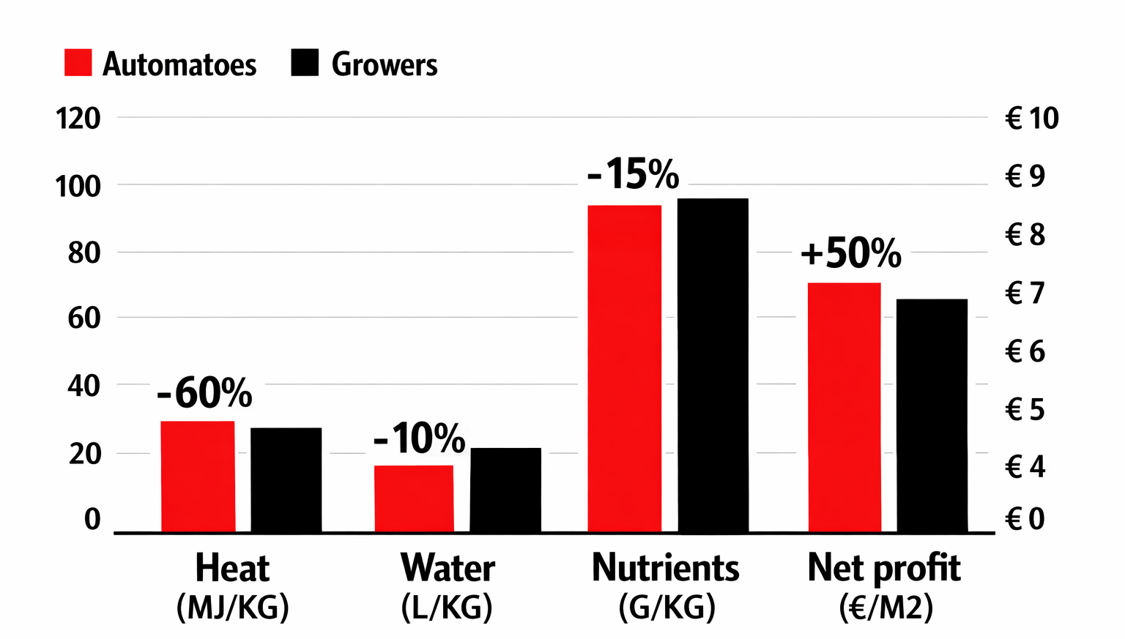
Autonomous greenhouse challenge
Results compared to the reference grower
Achieved a 50% increase in net profit
Enhance resource efficiency for sustainable growth
Boost tomato production while preserving the same rich flavour (Brix)
Outperform reference growers with superior results

Slide 7
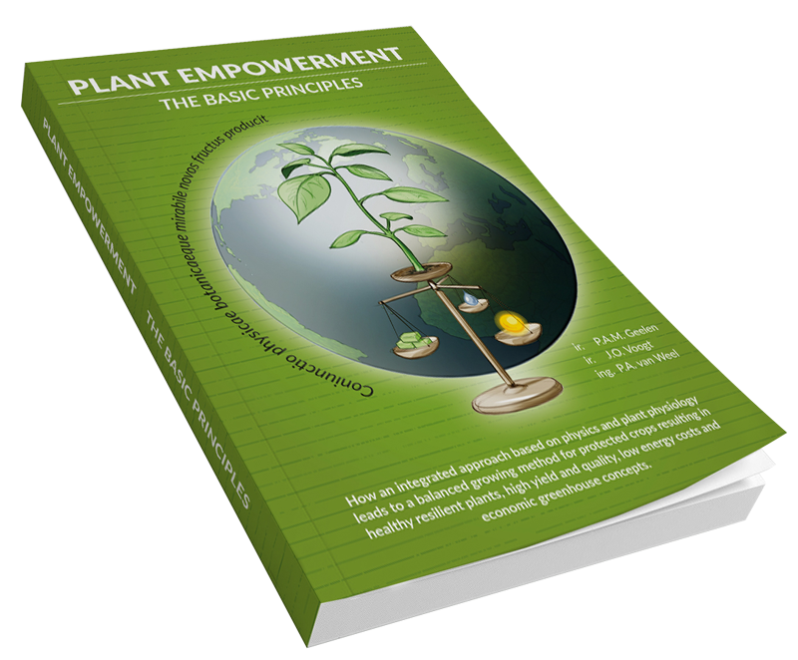
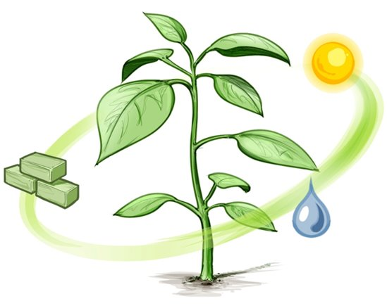
Autonomous greenhouse challenge
Using the principles of Plant Empowerment
Plant Empowerment is a cultivation method that emphasizes resource efficiency while maximizing crop yield and preserving nutritional quality.
Water Balance
Energy Balance
Assimilates Balance

Slide 8
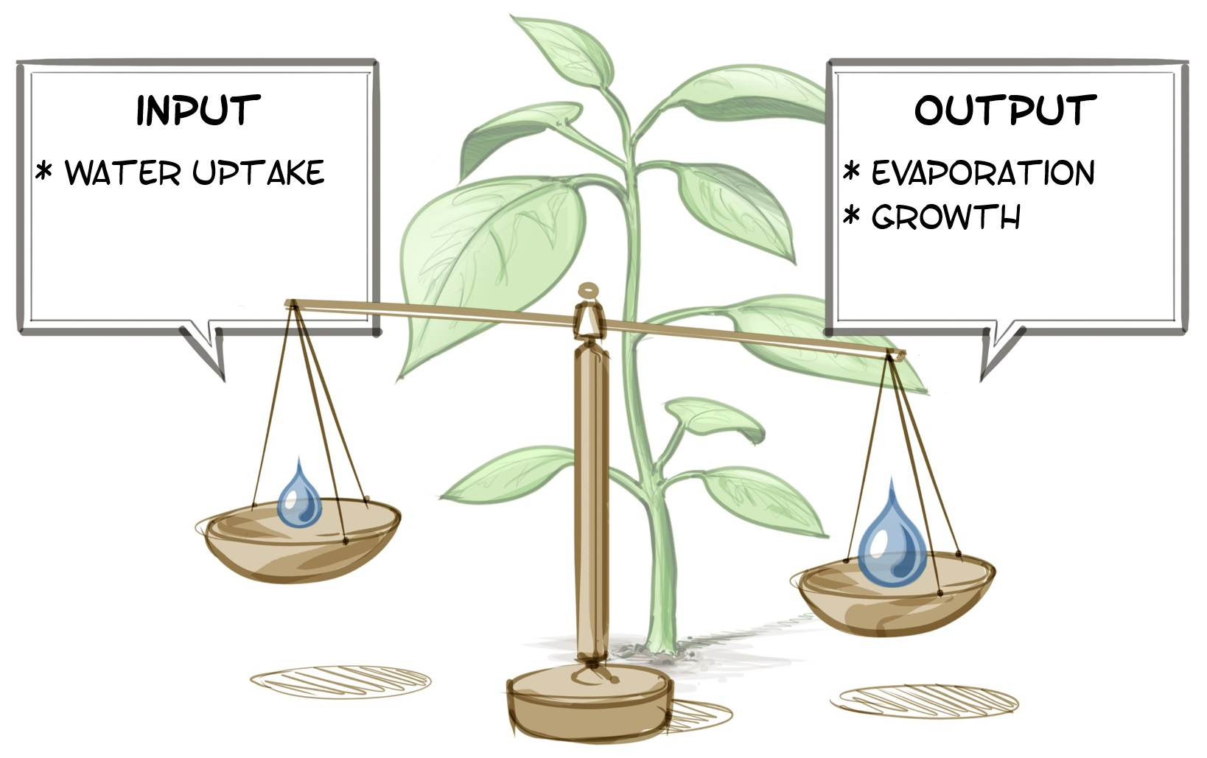
Water Balance
Plant empowerment
Input: Water uptake via the root system. Determined by:
root quality
oxygen levels in the root zone
EC and water potential of the substrate
irrigation strategy.
Output: Water loss via transpiration.
Determined by:
VPD (evaporative demand)
light (radiation)
leaf temperature
air velocity.
The plant takes center stage: not the dripper or the irrigation strategy, but rather what the plant is capable of, and needs to transpire.
Notes:
Waterbalans is geen irrigatiestrategie, maar een plantreactie Zonder verdamping → geen opname Klimaat (VPD!) stuurt wateropname meer dan de druppelaar

Slide 9
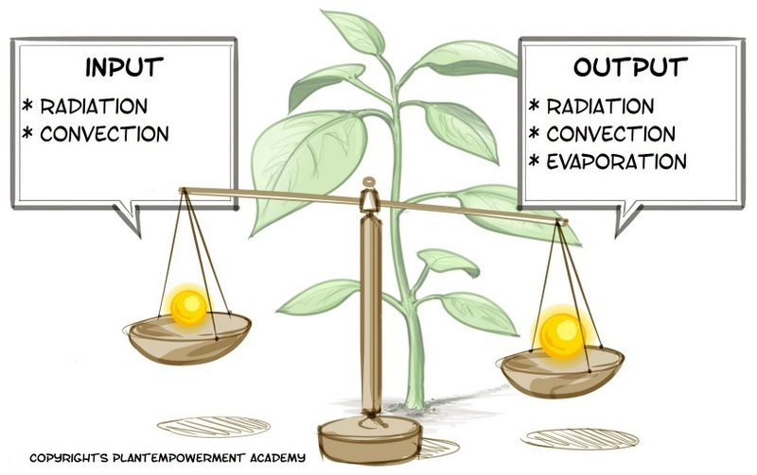
Energy balance
Plant empowerment
Input: Incoming radiation (light)
Influenced by:
outside radiation level
screen use
greenhouse transmission
light distribution in the crop
Output: Photosynthesis and evaporation (cooling)
Influenced by:
leaf temperature
air temperature
VPD
air movement
Notes:
Waterbalans is geen irrigatiestrategie, maar een plantreactie Zonder verdamping → geen opname Klimaat (VPD!) stuurt wateropname meer dan de druppelaar

Slide 10
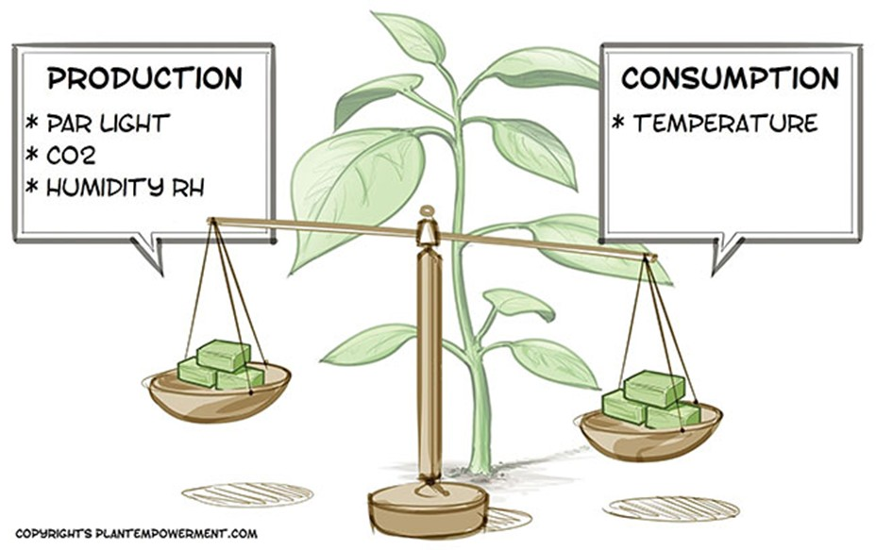
Assimilate balance
Plant empowerment
Production
PAR light
Amount of usable light for photosynthesis
Depends on radiation level, screens, lamp use, and light distribution in the crop
CO₂
Raw material for photosynthesis
Limited by CO₂ concentration around the leaf and air movement
Humidity (RH)
Influences stomatal opening
Affects CO₂ uptake and transpiration efficiency
Consumption
Temperature
Drives respiration and metabolic activity
High temperatures increase energy demand
Low temperatures slow down processes
Notes:
Waterbalans is geen irrigatiestrategie, maar een plantreactie Zonder verdamping → geen opname Klimaat (VPD!) stuurt wateropname meer dan de druppelaar

Slide 11
Plant empowerment
Summary
If the input exceeds the output, it indicates that an excessive amount of raw materials is being supplied, which the plants are unable to utilize.
If output exceeds input, it results in lost growth and a shortfall in production.
But how can we maintain balance? Biggest learning out of the AGC is the light use efficiency!

Slide 12
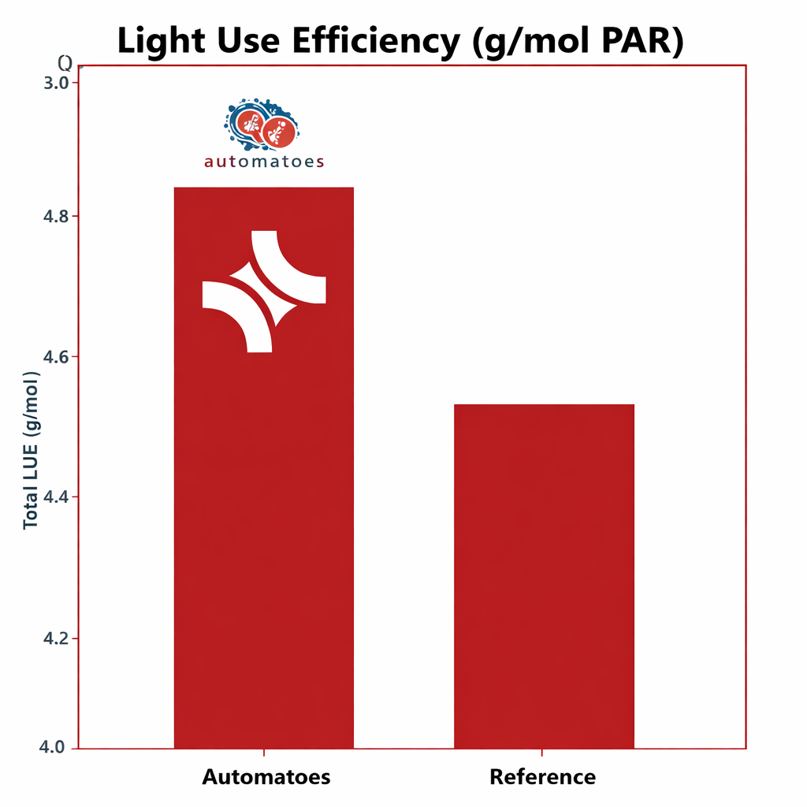

Autonomous greenhouse challenge
Highest light use efficiency
At the AGC, we attained the highest light use efficiency by implementing plant empowerment principles.

Slide 13
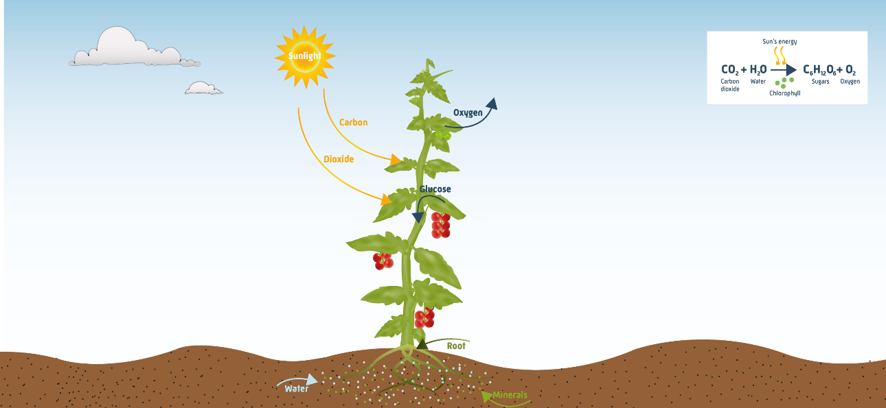
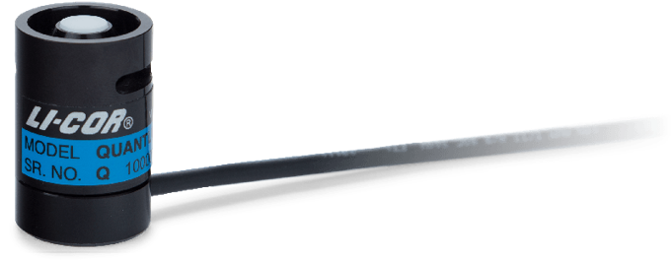

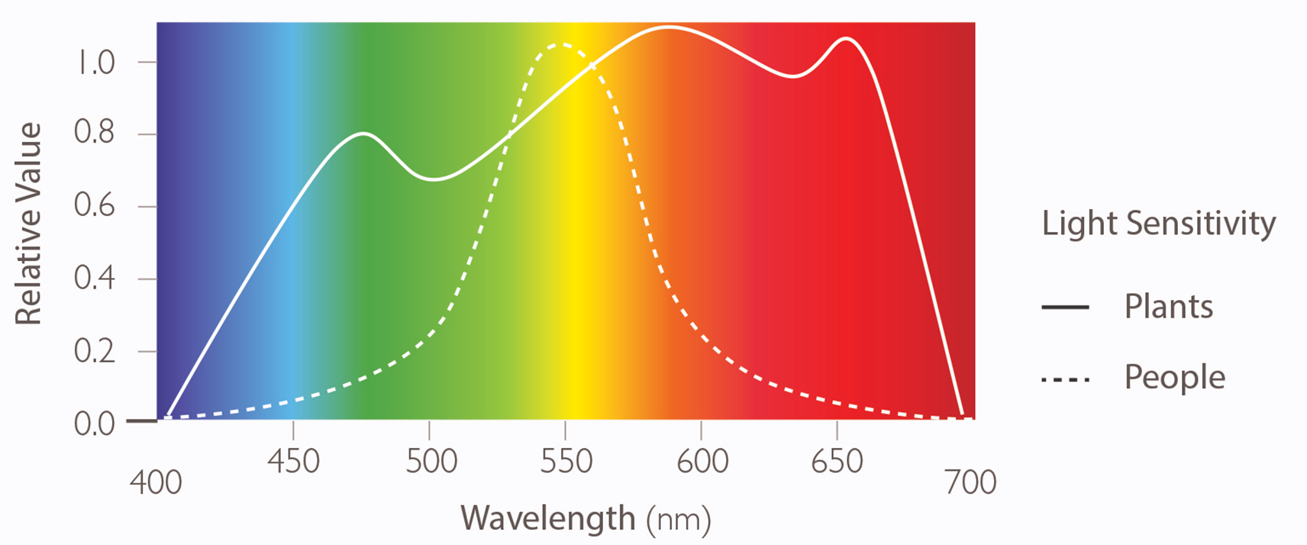
Autonomous greenhouse challenge
Tip: Start by maximizing assimilate production!
Combination of:​
PAR light​
CO2 ​
Stomata opening (VPD)​
Temperature ​

Slide 14
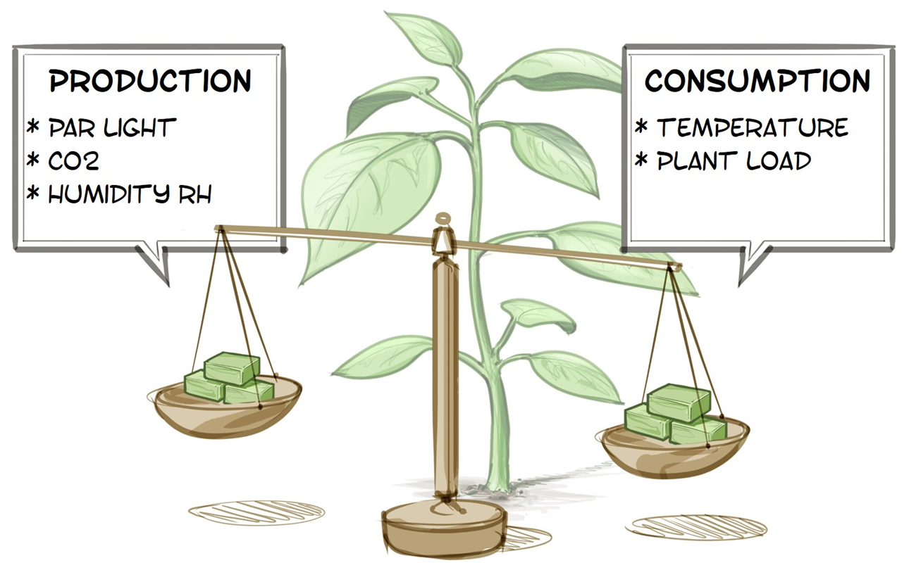
Autonomous greenhouse challenge
Maintain plant balance through the right temperature/light ratio
24hrs

Slide 15
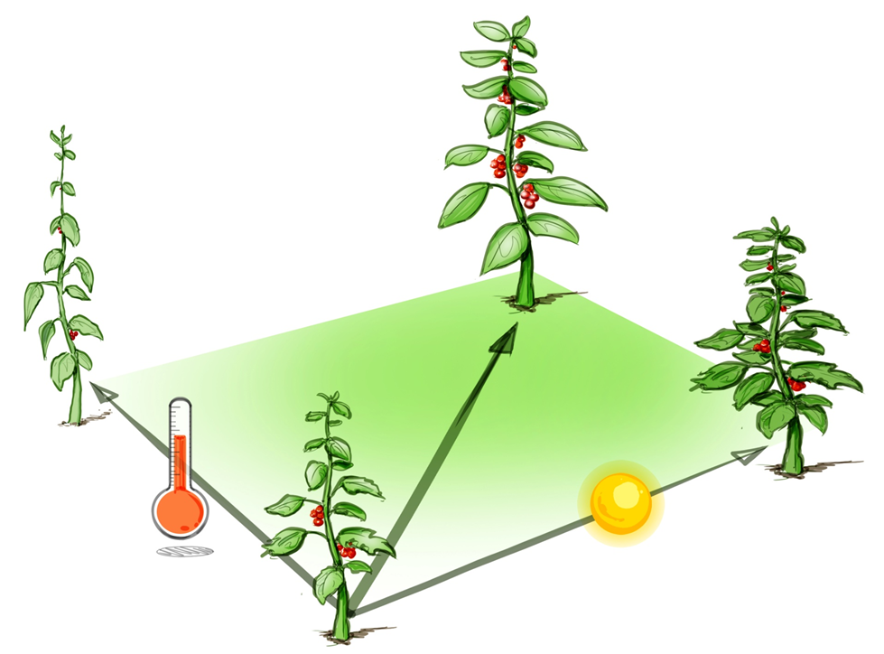
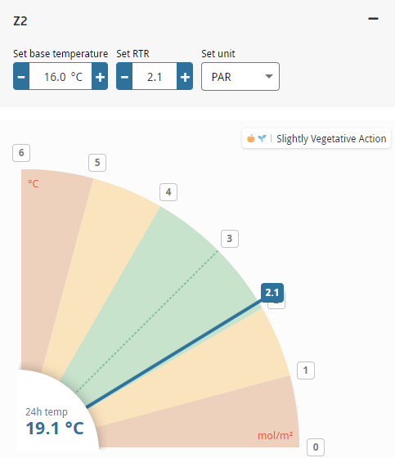
Autonomous greenhouse challenge
Using a Consistent Light / temperature Strategy (RTR)

Slide 16
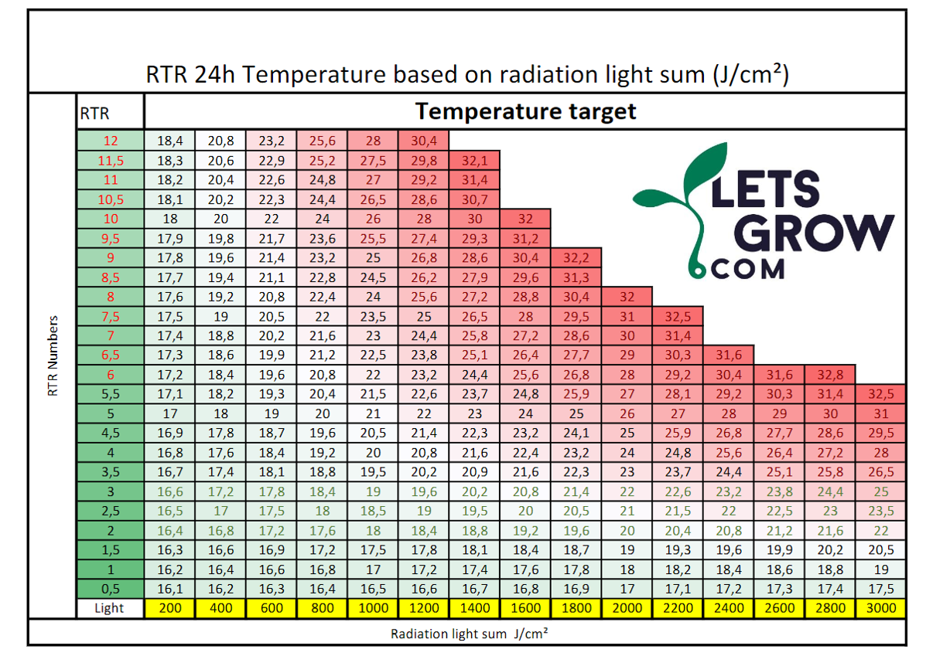
Autonomous greenhouse challenge
Using a Consistent Light / temperature Strategy (RTR)

Slide 17
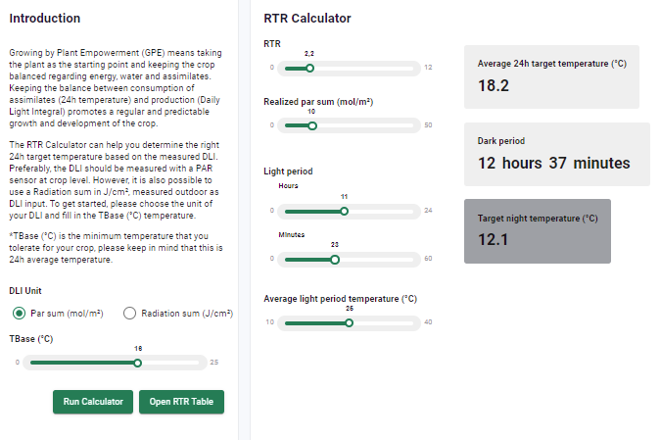
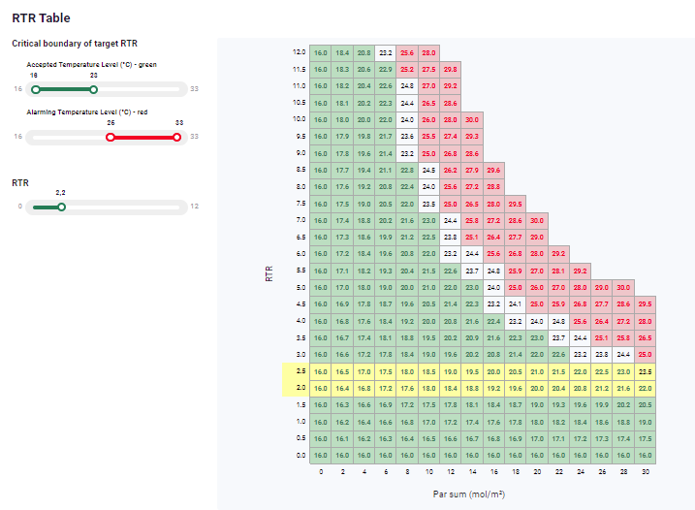
Calculate your own RTR now!
http://rtr.letsgrow.com/
Notes:
Values & Focus

Slide 18
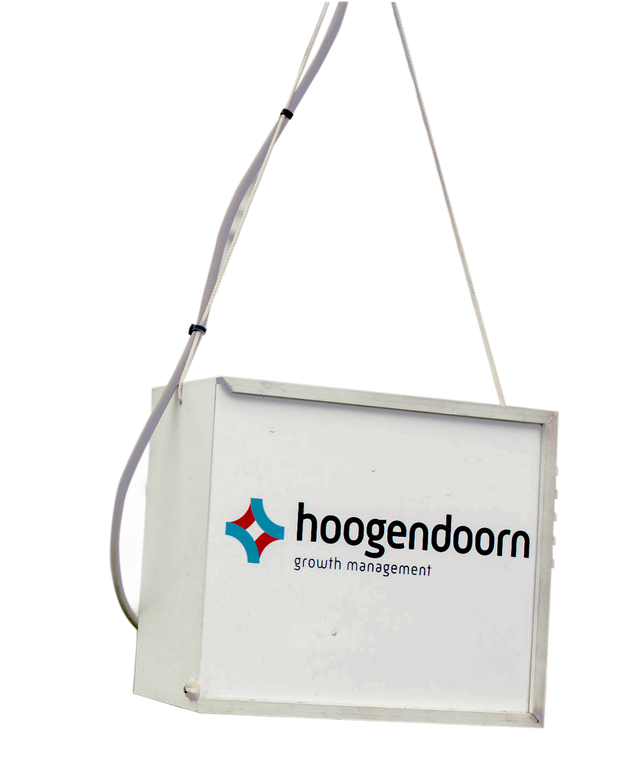
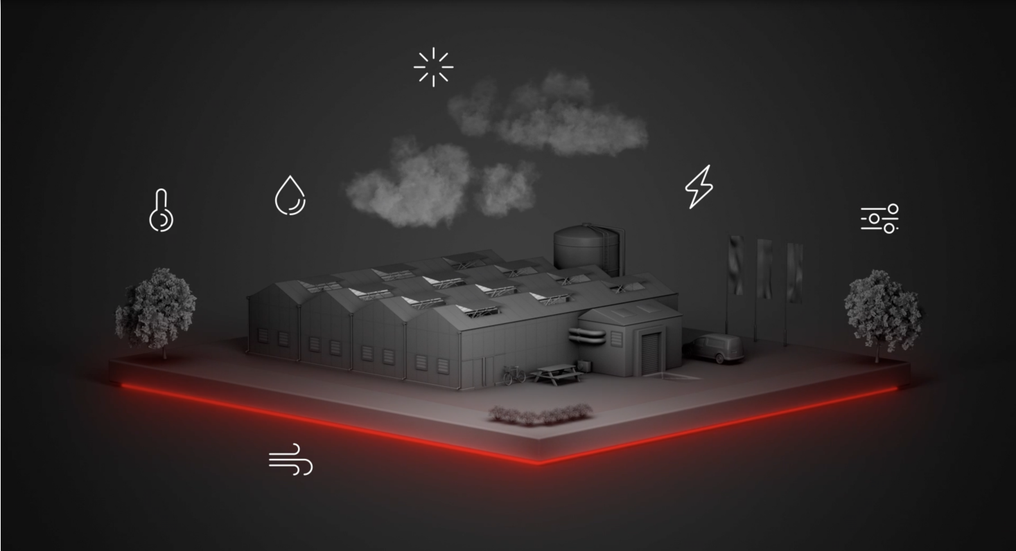
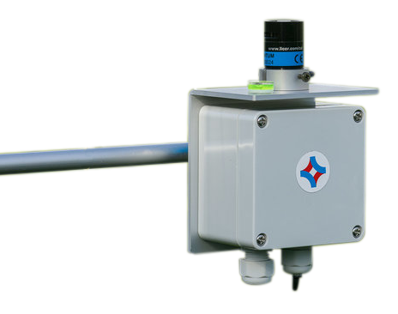
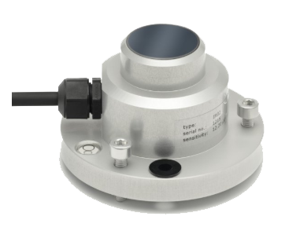

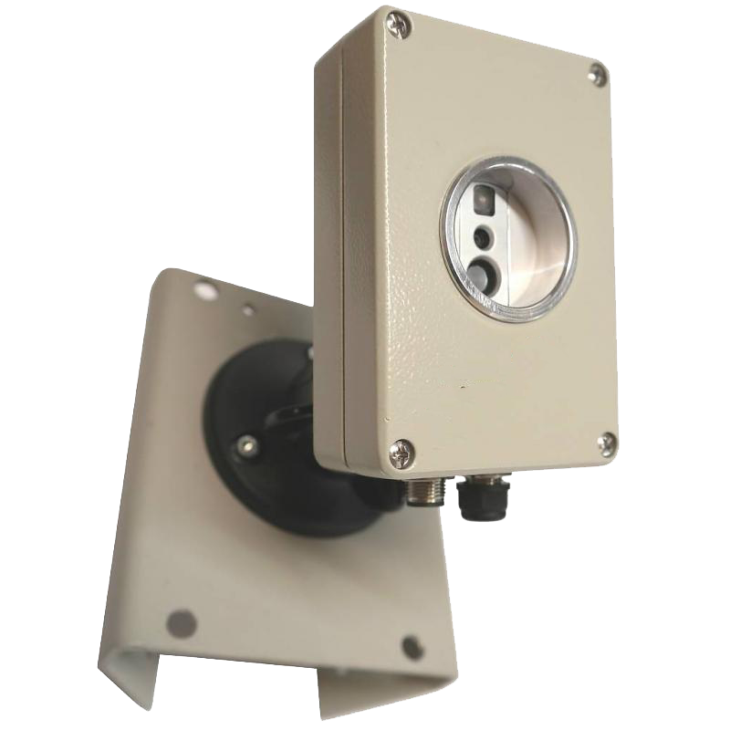
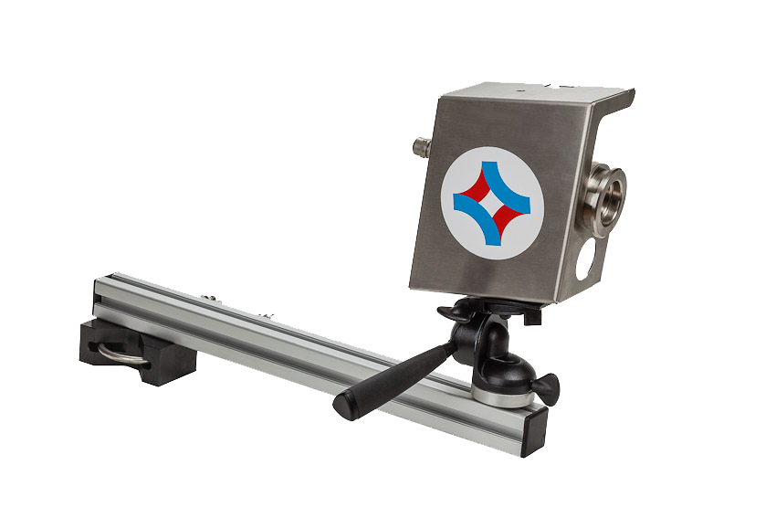
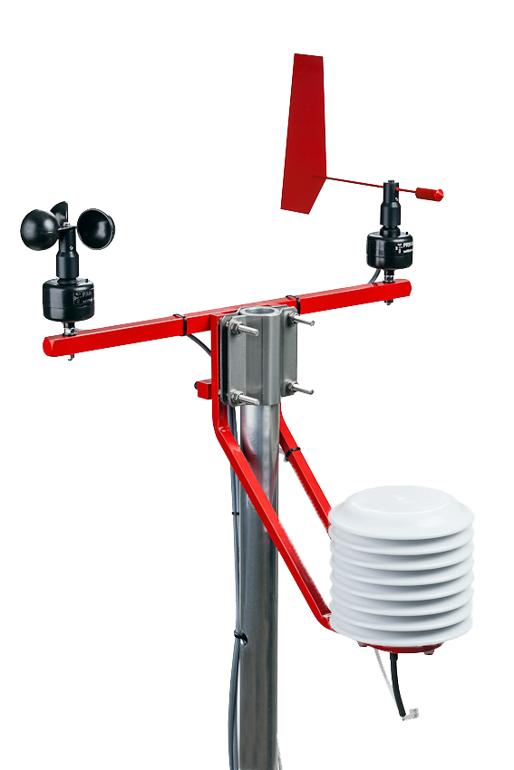
A Simple Sensor Kit
Notes:
Meteo + Outside RH / Pyrgeo
PAR sensor + PAR computed
Aspirator above screen (RH, Temperature)
Optional:
Plant Temperature (IR sensor)
Root Zone Temperature (if static / mobile)
Thermoview
Kas ververgroten.

Slide 19
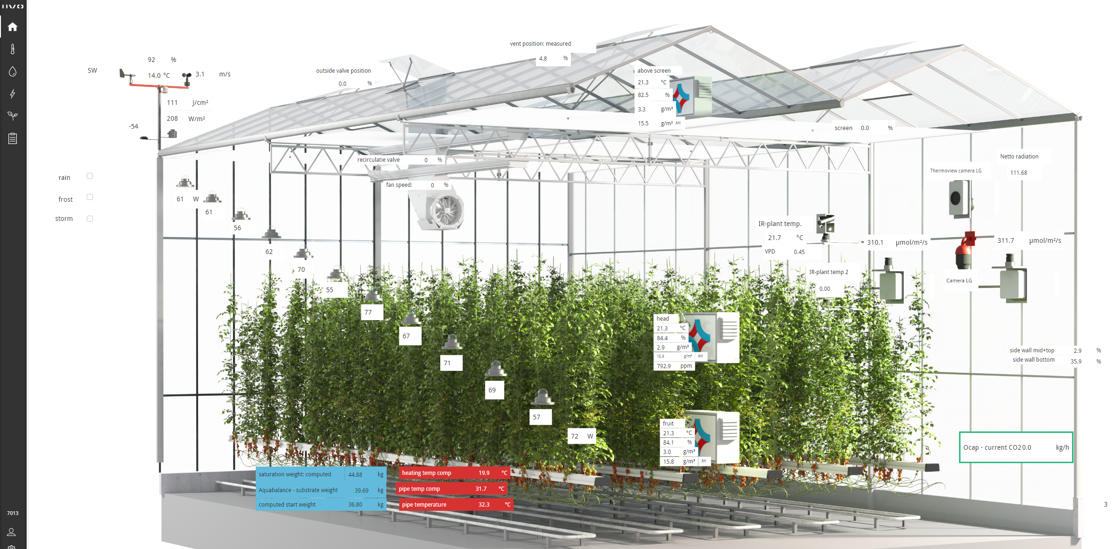
Sensor kit
What sensors do we see on the picture?

Slide 20
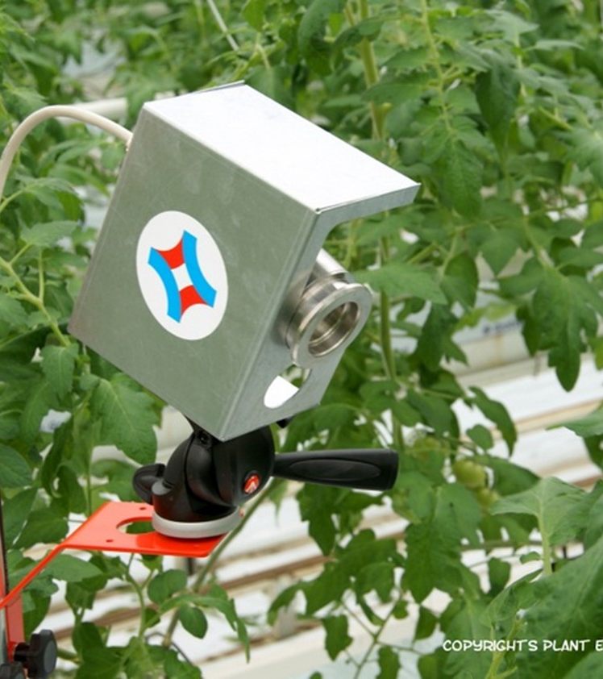
Infra red plant camera
How to get feedback from the plants
VPD – plant driven (Vapor pressure Deficit)
VPD describes the evaporative demand on the leaf
Leaf‑based VPD is calculated using: Leaf temperature Air temperature Relative humidity
What the plant camera reveals
Warm leaves → limited evaporation (low transpiration)
Cooler leaves → active transpiration and cooling
Link to the three plant balances:
Energy balance → leaf temperature shows energy surplus or deficit
Water balance → transpiration drives water and nutrient uptake
Assimilate balance → open stomata enable CO₂ uptake and production

Slide 21
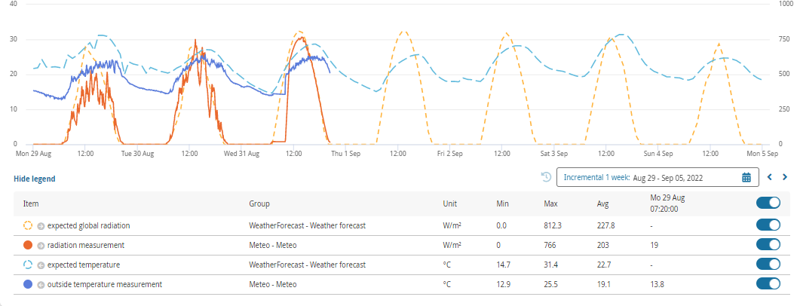
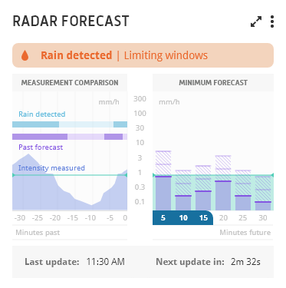
Autonomous greenhouse challenge
Weather forecast
Weather Forecast
Radar Forecast

Slide 22

At this point, we possess all the necessary information.
Meteo Data
Climate
Plant temperature
Plant health
Drain measurements
Irrigation & plant health
To become a successful grower in the future, it is essential to first grasp the physics of cultivation and understand plant behavior. After gaining that understanding, we can begin working with the data we have gathered.
Root-Zone Water Content
Irrigation & plant health
PAR light
Plant health & climate
Aspirators
Climate
CO2 Concentration
Climate
Notes:
Many growers have adopted basic sensors (like soil moisture probes, tensiometers, or climate sensors) to help, but even then the approach is often simplistic – e.g. irrigating when a single sensor drops below a threshold. In greenhouse surveys, most growers acknowledge they “generally rely on feelings and experience,” using data only as a rough guide . They may get readings on soil moisture or tank levels, but lack the time or tools to interpret multiple data streams together (soil moisture, humidity, solar radiation, crop growth stage, etc.). In fact, having a lot of data can become overwhelming without smart analytics. Farmers often find themselves inundated with numbers and charts – “Sometimes, the problem is that we have too much data,” as one producer put it – and this data overload can paralyze decision making . The result is that even with modern sensors, irrigation in many operations is not truly optimized: the grower might still default to manual control or ignore some data due to complexity
Gut feeling isn’t enough…” – Hard to juggle all factors by intuition; “Data overload!” – sensors everywhere, too many numbers.

Slide 23

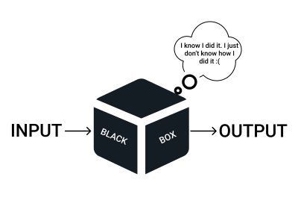
In what ways can contemporary technologies assist us

Slide 24


Slide 25
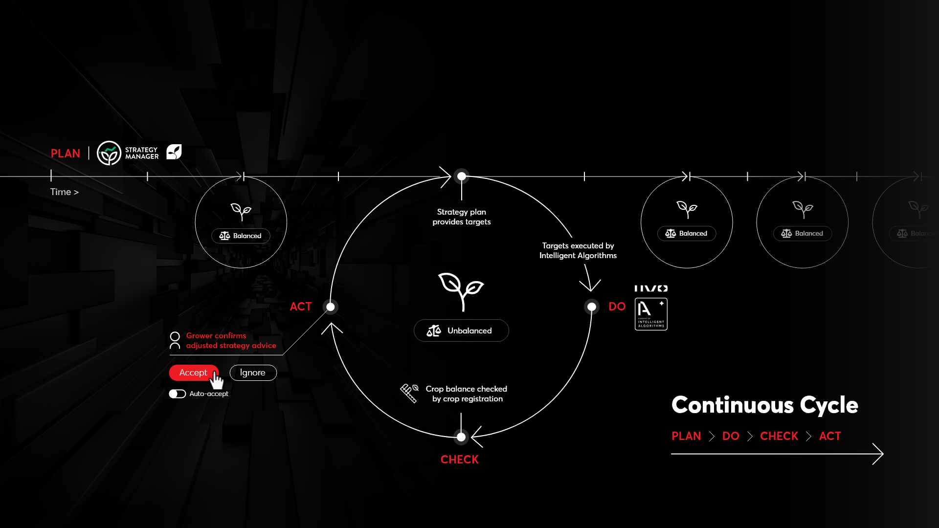

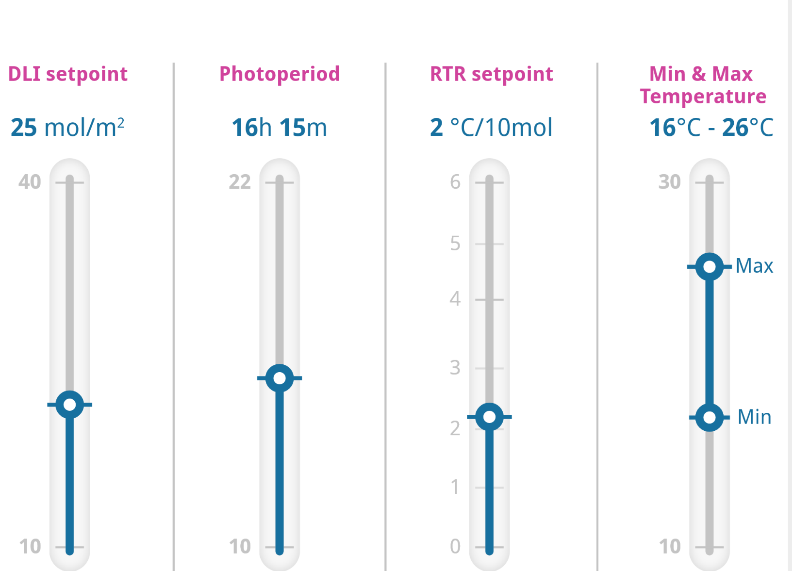
It Starts a with a plan

Slide 26

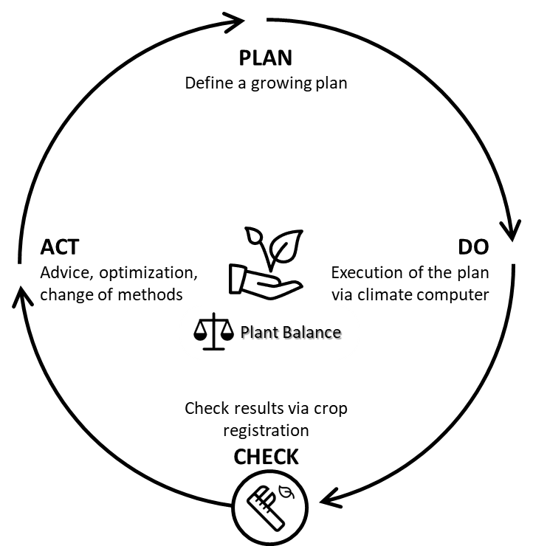
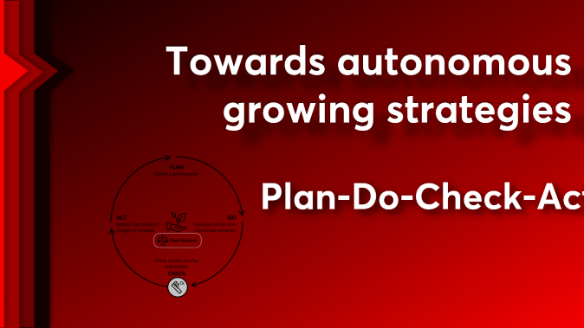
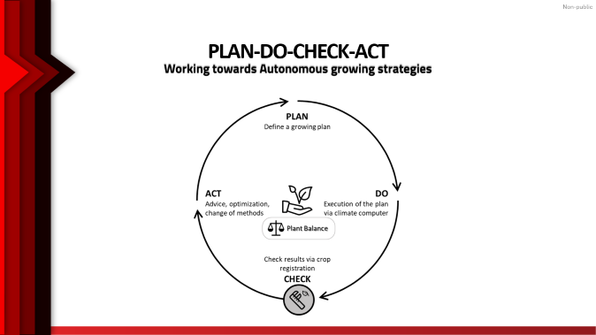

Slide 27
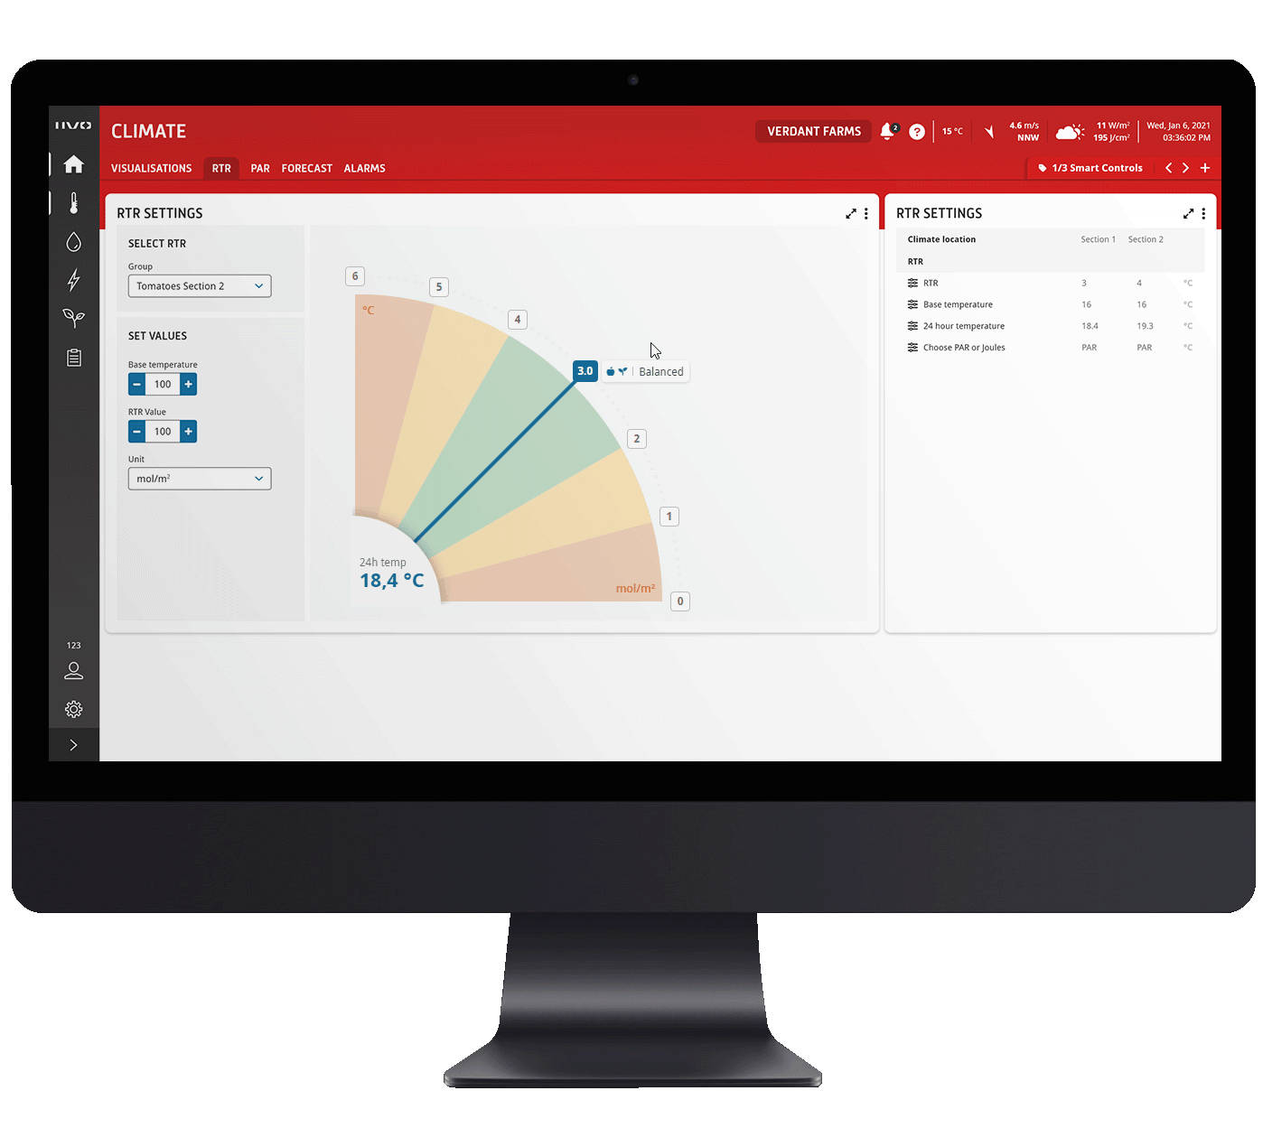
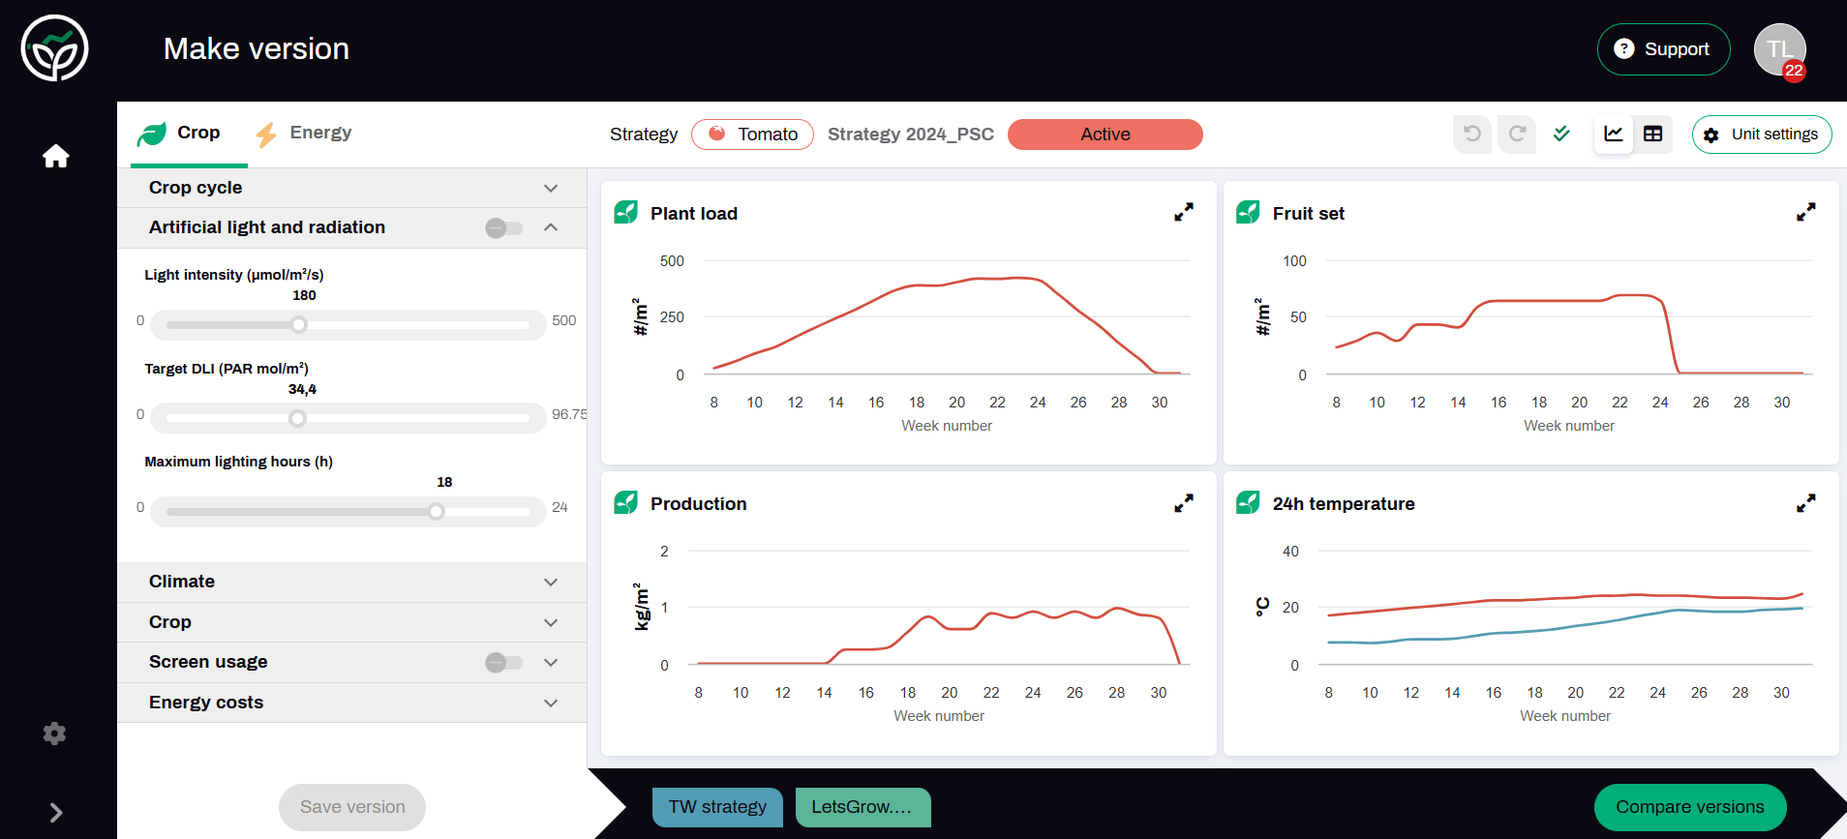
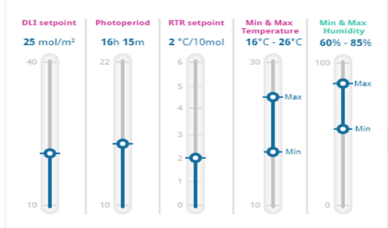
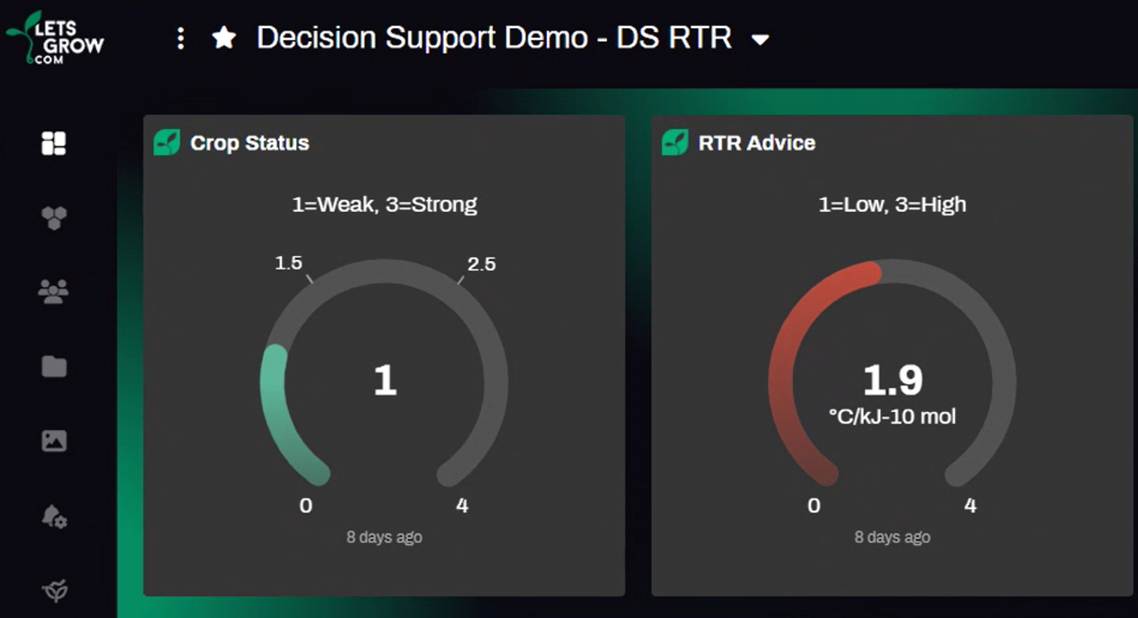
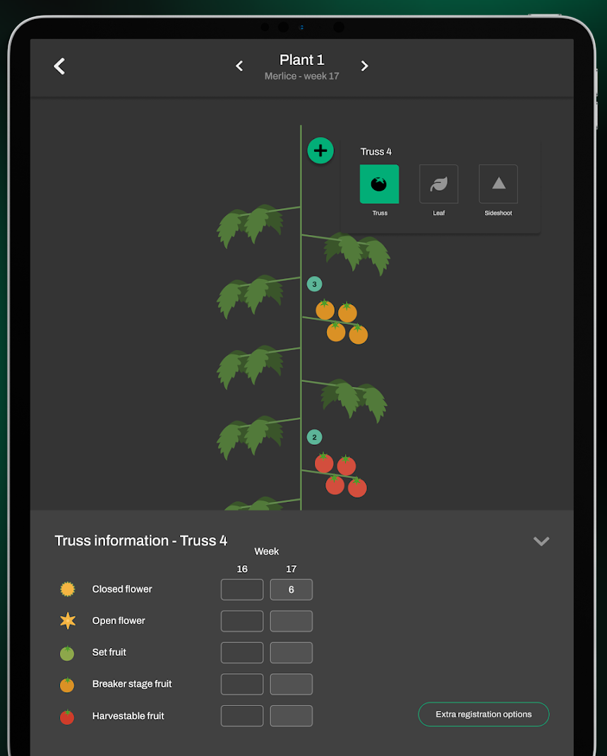

Plan-Do-Check-Act
P
C
A
D
Working towards Autonomous growing strategies
Plan
Check
Act
Do
Define a growing plan
Check the results via crop registration
Advice, optimization, change of methods
Execution of the plan via climate computers

Slide 28

P
D
C
A
Towards autonomous growing strategies
PLAN
DO
CHECK
ACT
Define a growing plan
Execution of the plan via climate computers
Check the results via crop registration
Advice, optimization, change of methods
Plan-Do-Check-Act
Notes:
Plan
Jaarplan qua teelt (Verwachte&Gewenste lichtsom in combinatie met gewenste RTR (verhouding temperatuur tot lichthoeveelheid) resulteerd in een gewenste etmaaletmaaltemperatruur en verwacht plantbelasting (aantal vruchten per moment van de teelt). Dit wordt in de Letsgrow Strategy manager ingevuld en gevisualiseerd.
Idee voor visualisatie: tijdlijn die over jaarplan van Strategy manager heen loopt
Do
Op basis van de berekende target values worden de streefwaarden van de Intelligent Algorithms automatisch aangepast.
Idee voo visualisatie”Schuifjes bewegen omhoog en omlaag waarna het draaien van het IIVO logo en er aangepaste teeltstrategie uitkomt
Check
Via de gewasregistratie app van Letsgrow wordt de gewasontwikkeling gevisualiseerd met als resultaat een soort van digital Twin
Idee voor visual: toon jong plantje met 1 a 2 bladeren en laat deze groeien waarbij de gewasregistratie dit visualiseert.
Indien er een verschil optreedt tussen verwacht/gewenst en de werkelijkheid wordt automatisch in letsgrow RTR Decision support een nieuwe hogere of lagere RTR berekend om de plant daarmee weer in “balans” te krijgen
Zie ook voorbeeld video https://www.youtube.com/watch?v=3zi-VytKbUY
Act
Door de dataverbinding en communicatie met de Hoogendoorn IIVO API worden de targets van de Intelligent Algorithm geoptimaliseerd op basis van de feedback vanuit de plant
Generiek idee voor visual. De teelt kan in beeld gebracht worden door verschuivende tijdijn, een groeiende plant (zie video van Letsrow) en stromen van (gewas)-data
Etc etc PDCA-cyclus
General summary:
Letsgrow Strategy Manager determines the optimal cultivation strategy, targets from this plan can be used as targets in the Intelligent Algorithms. This way we combine the strength of IA and Letsgrow Together!
Fyi zie oo khttps://www.linkedin.com/posts/delphy-greenhouse-horticulture_delphydigital-datadrivengrowing-activity-7275540284417949698-h3to/?utm_source=share&utm_medium=member_ios

Slide 29
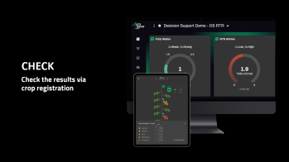
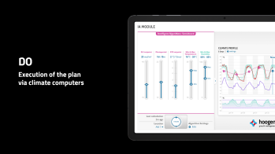





Towards autonomous growing strategies
P
C
A
D
Plan
Check
Act
Do
Define a growing plan
Check the results via crop registration
Advice, optimization, change of methods
Execution of the plan via climate computers
Plan-Do-Check-Act

Slide 30
PLAN
Define a growing plan

Slide 31

CHECK
Check the results via crop registration

Slide 32
ACT
Advice, optimization, change of methods

Slide 33
Intelligent algorithms
RTR setpoint based on PAR or Joules
Notes:
Radiation-Temperature Control (former TO Control) 辐射-温度控制（原TO控制）。
利用IIVO的辐射-温度控制，可以使内部条件与可用的外部条件相匹配。换句话说，温室的温度是基于可用的PAR光（来自太阳）。
With IIVO’s Radiation-Temperature Control it is possible to match the inside conditions to the available outside conditions. In other words, the greenhouse temperature is based on the available PAR light (from the sun).
辐射-温度平衡的24小时温度控制确保在24小时内实现温度和辐射之间的正确平衡。根据白天（光照期）的实际温度和夜间（黑暗期）的预期时间，计算出夜间的温度设置。
The 24-hour temperature control of the Radiation – Temperature Balance ensures a correct balance between temperature and radiation during a 24-hour period is realized. Based on the realized temperature during daytime (light period) and the expected duration of the night (dark period), the temperature setting for the night period is calculated.
这导致了对温室气候的最佳控制和可能的能源节约。导致植物的平衡和病虫害风险的最小化This leads to optimum control over your greenhouse climate and possible energy savings. Resulting in a balanced plant and minimized risk of pests and diseases.
结果： 保障最佳产量和质量。
The results: Optimum production and quality.
辐射-温度控制是用户友好型的，可以节省时间。该模块与现有的IIVO系统无缝集成。确保根据可用的阳光自动调整设置。
The Radiation-Temperature Control is user-friendly and saves time. The module is seamlessly integrated into existing IIVO actuations. Ensuring the settings are automatically adjusted based on the available sunlight.

Slide 34

BE THE
FUTURE GROWER
Notes:
Are you ready to be the future grower by using IIVO’s Intelligent Algorithms?

Slide 35


Customer Casus Lettuce
BASF Vegetable Seeds, NL
Increasing Light Use Efficiency resulting in up to 20-30% faster production process with identical or better quality
Optimization of production quality: tip burn is avoided by achieving the optimal growth climate
The greenhouse climate is being realized autonomously.
Employees only adjust the climate based on the RTR (Radiation Temperature Ratio)

Slide 36

Questions…?

